Slide 1
Unit 6: Introduction to the Viral Skills E-Thek

Slide 2
Introduction To VR Software
Virtual Reality is quite a powerful tool for learning and for putting knowledge into practice
Large platforms such as Google, Facebook, and big technology companies like Lenovo, Samsung, Sony… have decided to work on giving access to VR in the classroom.
Teachers and pedagogues are being trained in these new educational methods to make the most of them.

Slide 3
Unit 6:Viral Skills VR Applications
25 samples of VR applications have been taken. In a first filtering the selected VR applications have been catalogued and categorized according to:
Content
Interactivity
Video content
360º scenes
Self-creating experiences in VR.
Notes:
What do you know about the developments of VR in Europe?
Notes for trainers: you can also mention: However, over the last years, emerged also important VR initiatives in Finland, Denmark, Estonia, Italy, Poland, and Greece (Bezegová, Ledgard, Molemaker, Oberč, & Vigkos, 2017).
You can also make a graph based on the above info

Slide 4
Unit 6: Viral Skills E-THEK. VR Applications
Apart from the categorization described, each of them has been analyzed on the basis of the following parameters:
Name of VR application
Link
Category
Content
Cost
Ranking & Popularity
VR-Headset Interactive
Visualization/Experience
Create Material/ Lessons
Low-skilled/qualified learners

Slide 5
Unit 6: Viral Skills . VR Applications
Each organization should try and evaluate a minimum of 4 learning apps. For the selection of the VR apps, several parameters must be taken into account:
Language: VR learning applications should be in English (many apps have different languages to choose).
Cost: They should be free (some apps have a very low cost, and could be considered if worth being tested additionally)
Target: They should be suitable for adults in general and specifically for low skilled/qualified adults
Notes:
During the last years the Asian VR market has been growing at a high rate also driven by the support of local governments .

Slide 6
Unit 6:Viral Skills . VR Applications-Practice
We will then take a practical tour of the different VR applications selected, which will give an insight to each of them for the next phase. Observe, investigate, enjoy...
Various content:
YOU TUBE VR: https://www.youtube.com/watch?v=WsMjBMxpUTc
VR EDUCATION & LEARNING 360: https://play.google.com/store/apps/details?id=com.video.collection.playlist.vr.education.learn.kids&hl=es
CREATOR AVR: https://www.youtube.com/watch?v=PXXssqbHuuI
NYT VR: https://www.youtube.com/watch?v=FYP95WJmW3o
COSPACES: https://www.youtube.com/watch?v=zUR9i60zLo8
ARTE 360 VR: https://www.youtube.com/watch?v=AYl5Ay8FW_Y
Platform – Various content:
UNIMERSIV: https://www.youtube.com/watch?v=bCjWlPkJ19E
ENGAGE :https://www.youtube.com/watch?v=N0Zxw9zdx1U
WHITHIN: https://www.youtube.com/watch?v=bQ_MxE_UVUU
Notes:
During the last years the Asian VR market has been growing at a high rate also driven by the support of local governments .

Slide 7
Unit 6:Viral Skills . VR Applications-Practice
World/Sites
GOOGLE EXPEDITIONS: https://www.youtube.com/watch?v=Iw4T1WRSnig
GOOGLE EARTH VR: https://www.youtube.com/watch?v=SCrkZOx5Q1M
WONDERS OF DE WORLD: https://www.youtube.com/watch?v=AhVhiq_n6Rk
Virtual museum
GOOGLE ARTS& CULTURE: https://www.youtube.com/watch?v=ln-SceumPlI
SKETCHFAB : https://www.youtube.com/watch?v=oedwL72p5ks
Human body/anatomy:
ANATOMYOU: https://www.youtube.com/watch?v=jDXbv1heTw0
Mathemathics /Chemistry:
CALCFLOW: https://www.youtube.com/watch?v=L-S7nP-ojqo
TIME TABLES VR:https://www.youtube.com/watch?time_continue=11&v=8hfxsRbvZhw&feature=emb_title
NANOME: https://www.youtube.com/watch?v=gCNbuH9Y6hU
Notes:
During the last years the Asian VR market has been growing at a high rate also driven by the support of local governments .

Slide 8
Unit 6:Viral Skills . VR Applications-Practice
Space:
INTERNATIONAL SPACE STATION TOUR VR: https://www.youtube.com/watch?v=vnpYvz2Ledc : https://www.youtube.com/watch?v=Ae7P4N6lx_k
TITANS OF SPACE: https://www.youtube.com/watch?v=VHGwHffNQV0
BBC HOME A VR SPACEWALK : https://www.youtube.com/watch?v=yj9dReMaZuE
Language Learning:
MONDLY: LEARN LANGUAGESVR : https://www.youtube.com/watch?v=KmSN3-KG6cg
VIRTUAL VOCAB: SPANISH IN VR;
Training:
VITUAL SPEECH –VR COURSE: https://www.youtube.com/watch?v=I_H8AY1tcjg
:https://www.youtube.com/watch?v=LwqgCiYqx0M
AMAZON SUMERIAN: https://www.youtube.com/watch?v=D8OTzUZzq7s
https://www.youtube.com/watch?v=oVSVvnu3deI
https://www.youtube.com/watch?v=aFNa6DTrfKc
Notes:
During the last years the Asian VR market has been growing at a high rate also driven by the support of local governments .

Slide 9
Unit 6:Viral Skills . VR Applications-Practice
Visual Impairment:
NOTES ON BLINDNES : https://www.youtube.com/watch?v=9ViF0GBt6fQ
History. Second World War:
ANNE FRANK HOUSE VR: https://www.youtube.com/watch?v=HCFUuyi-lIc
Sport, Music, Social Events:
OCULUS VENUES :https://www.youtube.com/watch?v=4HAaMVUr16g
https://www.youtube.com/watch?v=IKoVaYKjYNY
Notes:
During the last years the Asian VR market has been growing at a high rate also driven by the support of local governments .

Slide 10
Unit 6:Viral Skills E-THEK.
After the validation of the selection parameters, the corresponding E-THEK template is completed. For this purpose, a template (E-Thek) has been created to facilitate the collection of data and to draw the right conclusions
The partners have used this template with each of the VR applications, all of them suitable for adult learners with low qualifications.
The E-Thek is designed to analyze the VR Application, with its corresponding name and category.
Notes:
During the last years the Asian VR market has been growing at a high rate also driven by the support of local governments .

Slide 11
Unit 6:Viral Skills E-THEK.
Each partner has completed the technical framework, the key data of each VR application and its compatibility with the different VR hardware systems, operating systems and languages will be taken into account.
As for the contents of the VR application, the partners have considered which learning content it provides and what the Learning Outcomes are after using it, based on: Knowledge, Skills, and Competences.
the activities provided and whether they bring added value to low-skilled and low-qualified adult learners.
A rating scale for the application has been included taking into account the application level, ease of use, gamification level as well as the pedagogic orientation and standards.
The objective of the SWOT analysis, of the different selected VR applications, will facilitate the adaptation of each one of them to the most suitable student-teacher context.
a set of standards/rules will be considered to improve or guide the learning through each of the VR applications.
Notes:
During the last years the Asian VR market has been growing at a high rate also driven by the support of local governments .

Slide 12
Unit 6: Viral Skills E-THEK.
Thanks to the analysis (E-Thek) we can see one of the biggest advantages of using VR technology in the education area: the possibility of living impossible or almost impossible experiences
Notes:
During the last years the Asian VR market has been growing at a high rate also driven by the support of local governments .

Slide 13
Unit 6:Viral Skills E-THEK. TEMPLATE
Notes:
During the last years the Asian VR market has been growing at a high rate also driven by the support of local governments .

Slide 14
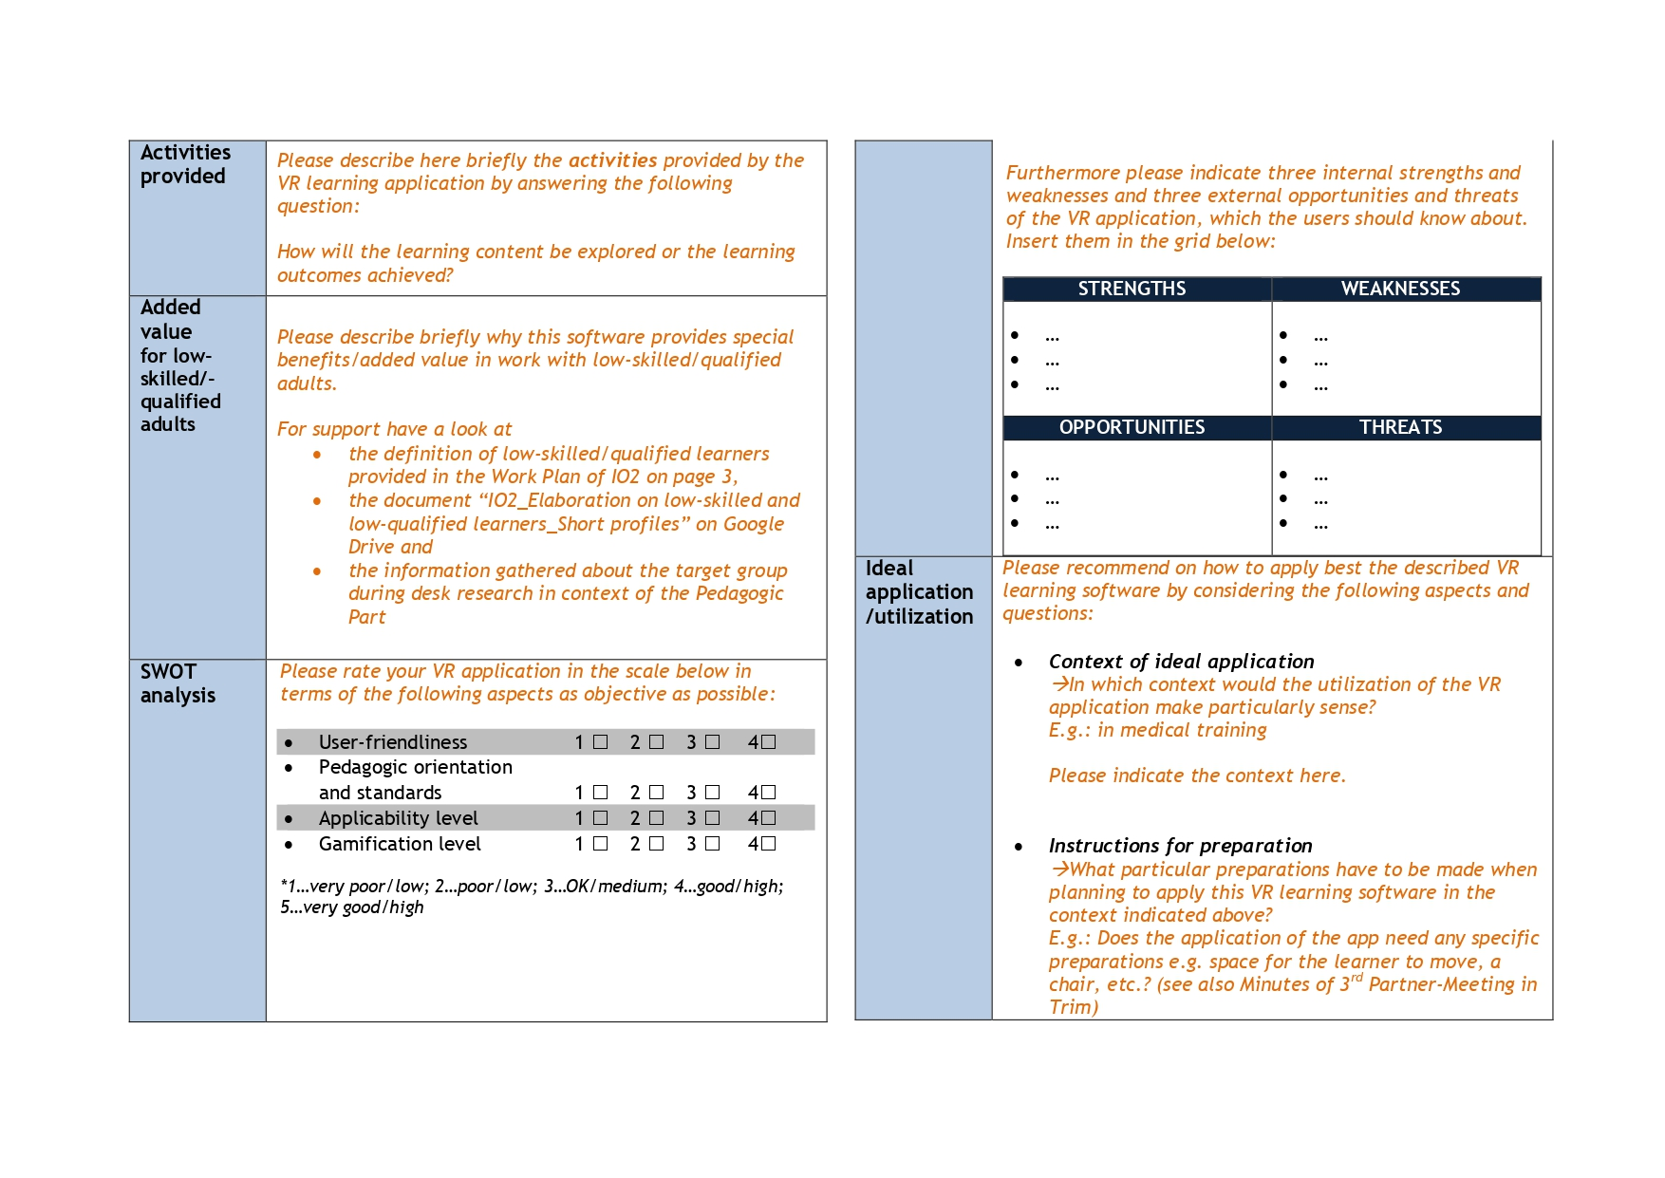
Unit 6:Viral Skills E-THEK. TEMPLATE
Notes:
During the last years the Asian VR market has been growing at a high rate also driven by the support of local governments .

Slide 15
Unit 6:Viral Skills E-THEK. TEMPLATE
Notes:
During the last years the Asian VR market has been growing at a high rate also driven by the support of local governments .

Slide 16
Testing session 1.GOOGLE EARHT VR:https://arvr.google.com/earth/
Each participant will try to visualize the locations and monuments chosen as World Heritage Sites by UNESCO in Europe.

Slide 17
Testing session 2.WITHIN VR:https://www.with.in/
Practice 1: CNN: Iceland is Melting.
Fly over Iceland's most famous natural wonders and discover how climate change could make it all disappear.

Slide 18
Testing session 2.WITHIN VR
Practice 2: CNN: Toro Bravo.
Every year, thousands of amateur daredevils flock to Pamplona in the hopes of coming face-to-face with Toro Bravo – the Spanish Fighting Bull. Now, witness Spain’s intense and controversial spectacle, Running of the Bulls, up close like

