Slide 1
Introduction to Virtual Reality

Slide 2
Introduction to Virtual Reality
Introduction to the field of Virtual Reality
Discussion
Introduction to hard- and software
  Focus – Stand-alone systems
  Focus – PC-based systems
  Focus – Smartphone-based systems
Questions

Slide 3
Ice breaker game
One Truth and two Tales
Introduce yourself and makes three statements of which one is true and two are tales
Group: Guess! Which is TRUE?

Slide 4
Introdcution to the field of virtual reality

Slide 5
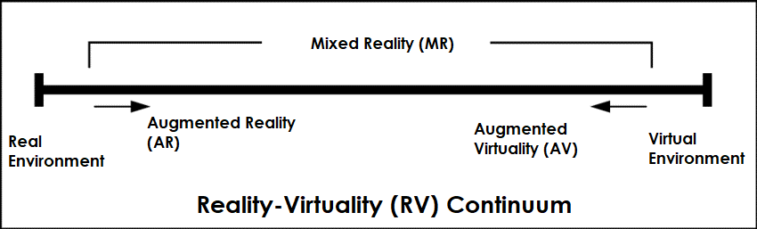
Reality-Virtuality (RV) Continuum
VR Technology – Reality-Virtuality (RV) Continuum
Reality-virtuality continuum. The scale shows the transition between the real and virtual worlds.[*]
[*] Adapted by Gamper, H. (2019). Audio augmented reality in telecommunication.
Mixed Reality: “reality spectrum” ranging between pure “reality” (without computer intervention) and pure “Virtual Reality” (a computer-generated environment). MR is any environment that incorporates aspects of both ends of this spectrum, such as overlaying virtual objects on top of a user's field of view of a real space.
Milgram P., Kishino F. (1994), Taxonomy of mixed reality visual displays, IEICE Transactions on Information and Systems, pp. 1321-1329.

Slide 6
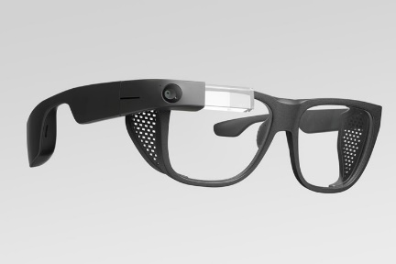
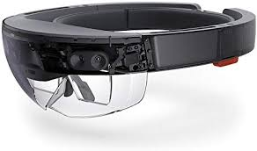
Augmented Reality
Augmented Reality (AR): a real-world environment enhanced with computer-generated information such as sound, video or graphics
‘Wearable Augmented Reality Devices” - Microsoft Hololens or Google Glass
“Wearable Augmented Reality Devices” capture and processes a user’s physical environment and augments it with virtual objects
additional information, objects or abstract elements are blended into the users’ field of vision
user is still able to notice, observe and participate with the real environment
Text, objects and elements are experienced as co-existent to the real surroundings but can be interacted with by use sensor-functionalities in real time

Slide 7
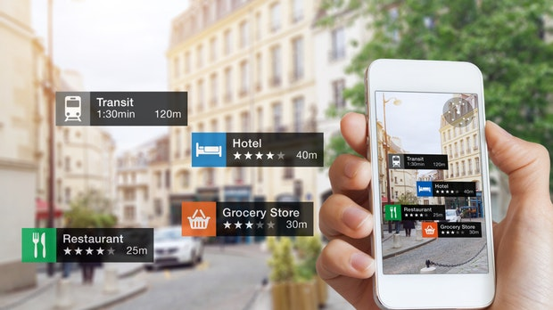
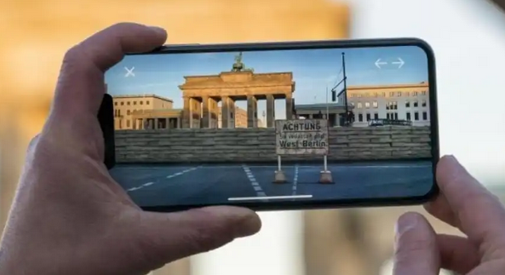
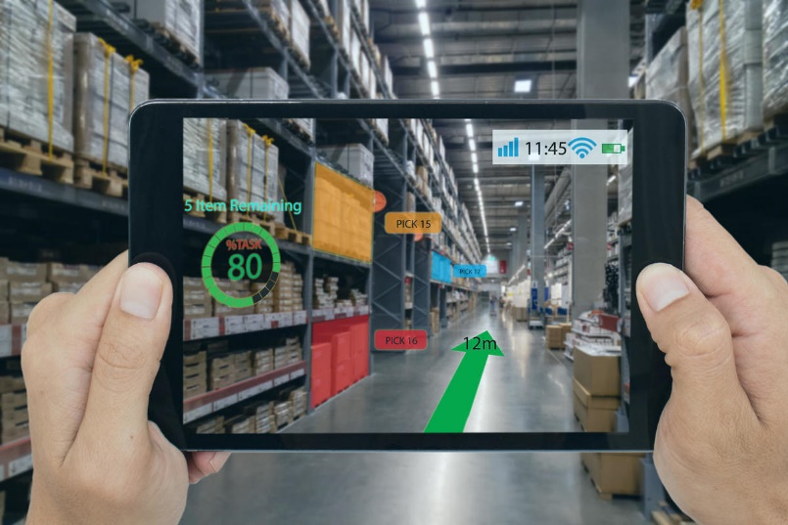
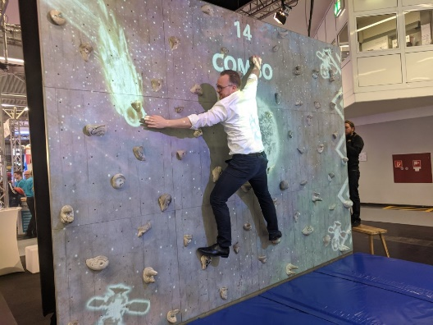
Augmented Reality

Slide 8
Virtual Reality
many different definitions for the phenomenon of virtual reality
Reasons for a different understanding of the term lie in different user environments, different user settings, various areas of application and foci on different aspects of ergonomics
Brill (2009) describes virtual reality as a “simulated reality setting where interactive elements provides a fully immersive environment”
Yet, for a true immersive impact, further elements are important;
  the virtual world itself
  the sensory feedback and interactions between the elements of the virtual world
  the user
Contrary to a true perception of reality, virtual reality allows the user to choose and change between different positions (within the virtual world) and points of view on elements of the virtual world
By doing so, events, occurrences of the story within the virtual world be actively be influenced and created

Slide 9
Virtual Reality
Woodford (2019) “Virtual Reality needs to be:
Believable: The user really needs to feel like being in a virtual world to keep believing that, or the illusion of Virtual Reality will disappear.
Interactive: While moving around, the VR world needs to move simultaneously”.
Explorable: A VR world needs to be big and detailed enough for the user to explore. Although, as Woodford (2019) further pinpoints, a painting can be realistic as well, it only illustrates one scene, from one perspective. A book can also transport the reader into a "virtual world," but the user is essentially only able to explore this world in a linear way.
Immersive: To be both believable and interactive, VR needs to engage both, the user’s body and the user’s mind. Paintings by artists can give the observer a glimpse of a scene or historic event, but the viewers can never fully convey the sight, sound, smell, taste, and feel of that scene or event.
Computer-generated: Only powerful machines, with realistic 3D computer graphics, are fast enough to create believable, interactive, alternative worlds that change in real-time as the user moves around them”.

Slide 10
Virtual Reality
….experts report, that users are still interested if the software allows high personal involvement.
Here, 6DoF (Six degrees of freedom), describing the freedom of movement of a rigid body in three-dimensional space, is regarded as essential for delivering a superior immersive experience
‘Degrees of freedom (DoF) refer to the number of basic ways a rigid object can move through 3D space. There are six total degrees of freedom. Three correspond to rotational movement around the x, y, and z axes, commonly termed pitch, yaw, and roll. The other three correspond to translational movement along those axes, which can be thought of as moving forward or backward, moving left or right, and moving up or down. Besides an extensive educational training and the necessary technical instructions, the interview experts emphasise that trainers and learners should be creative in nature and generally be interested in evolving technologies.’

Slide 11
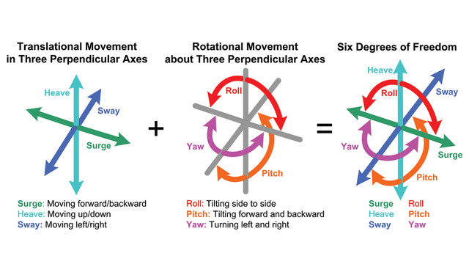
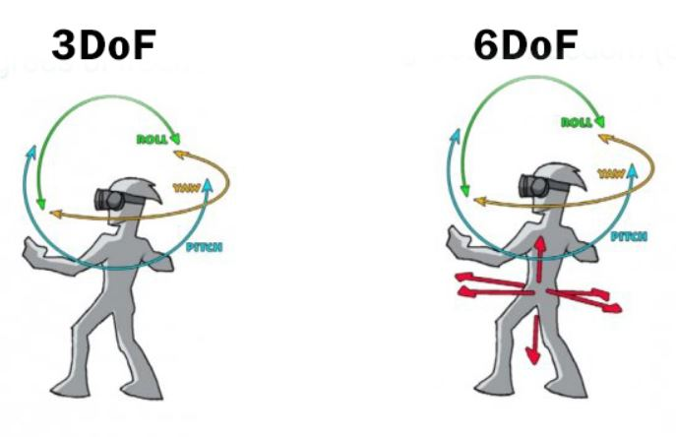
Virtual Reality

Slide 12
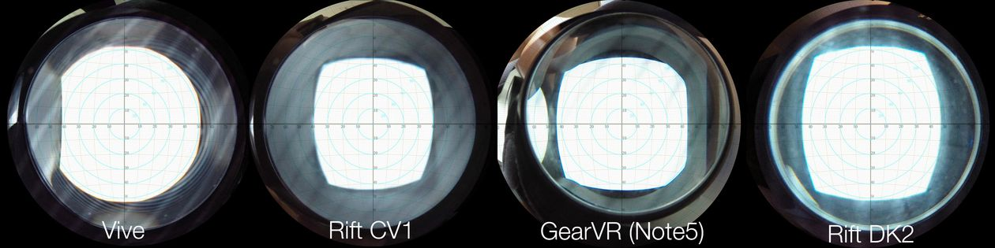
Virtual Reality
FIELD OF VIEW
Oculus Rift & HTC almost same resolution; still different picture?

Slide 13
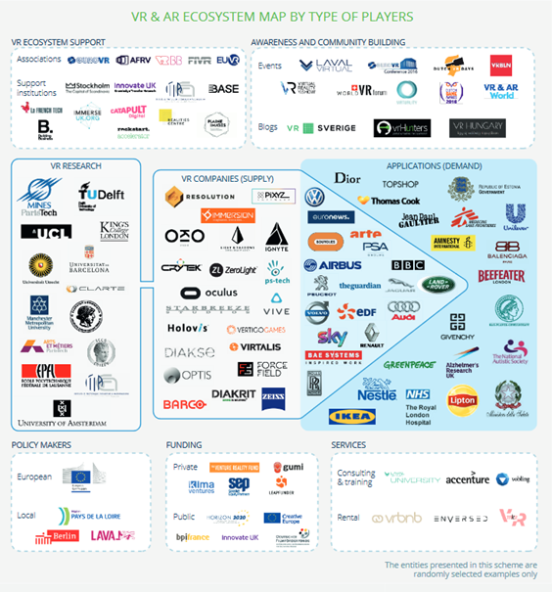
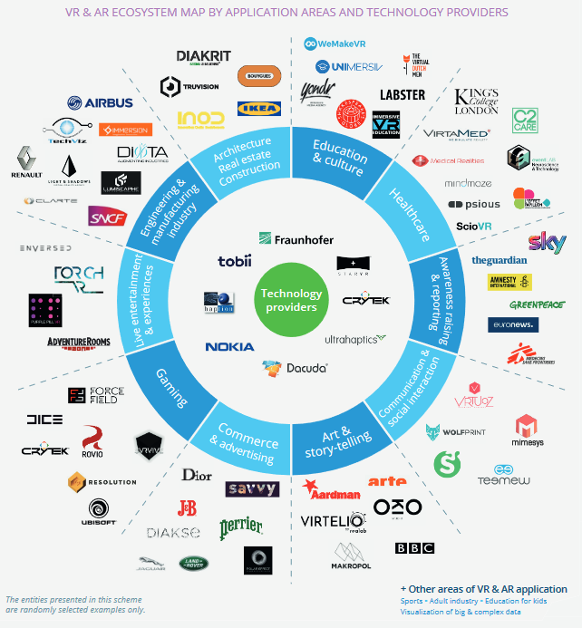
Virtual Reality
Nepal and Tang (2017) “today the Virtual Reality technology is applied to advance fields of medicine, engineering, education, design, training, and entertainment.
Bezegova, B., Ledgard, M., Molemaker, R., Oberc, B., Vikos, A. (2019), Virtual Reality and its potential for Europe, Ecorys.

Slide 14
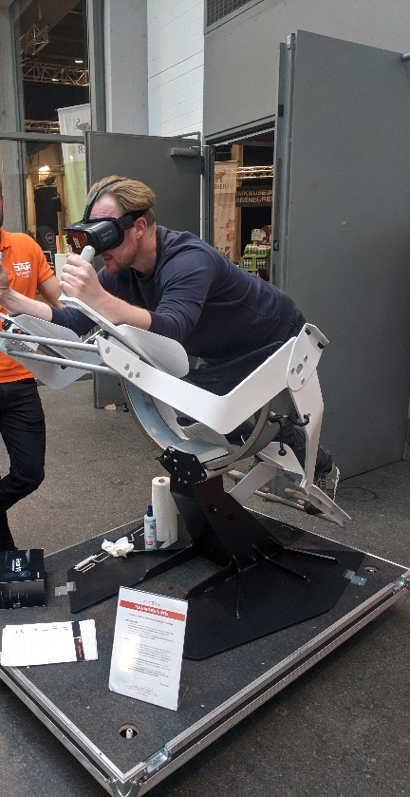
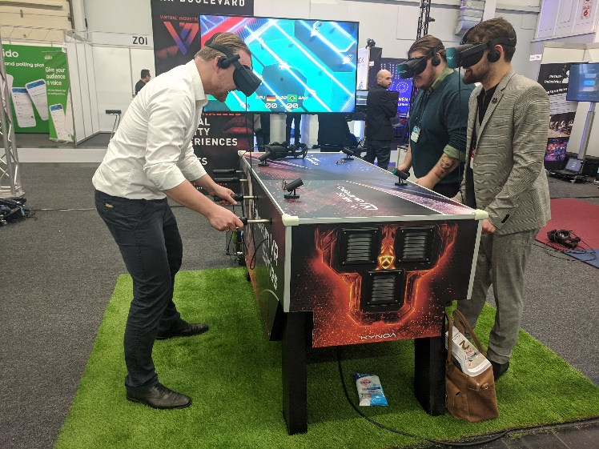
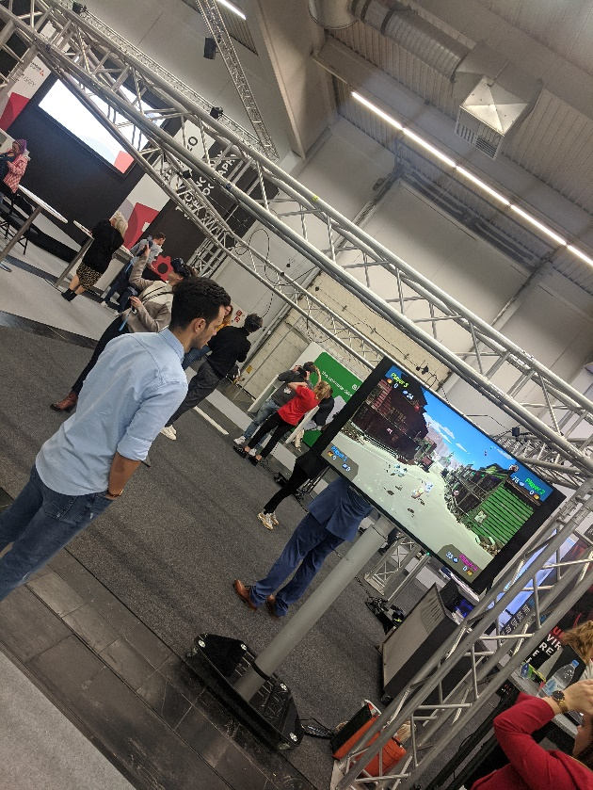
Virtual Reality
ENTERTAINMENT & SIDE EFFECTS

Slide 15
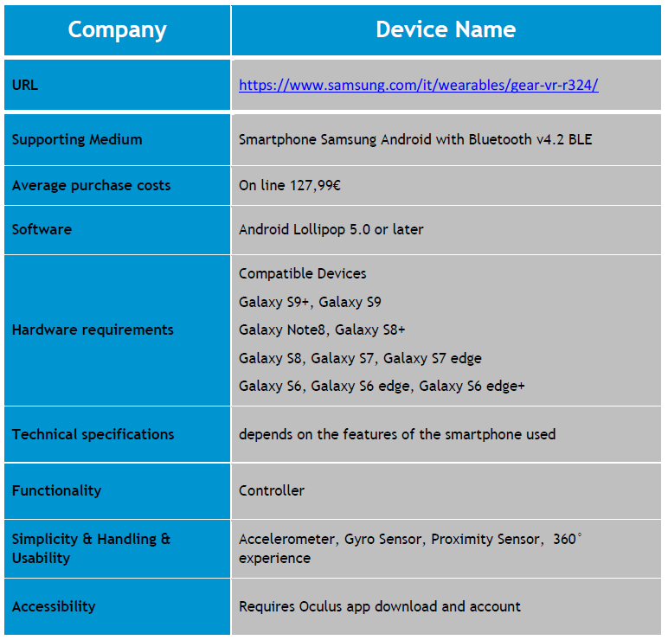
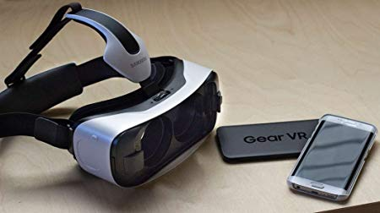
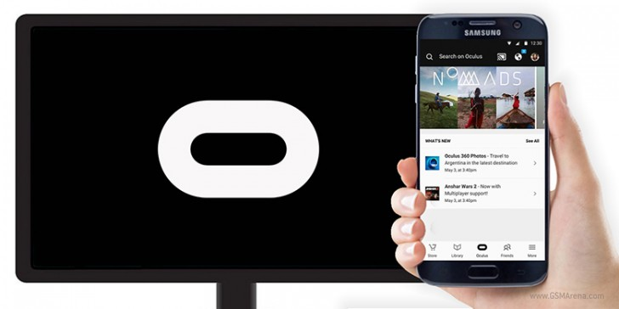
Smartphone-Based Hard- and Software
Samsung Gear VR

Slide 16
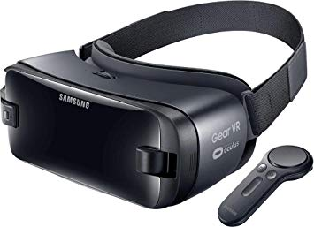
Smartphone-Based Hard- and Software
SAMSUNG GEAR VR

Slide 17
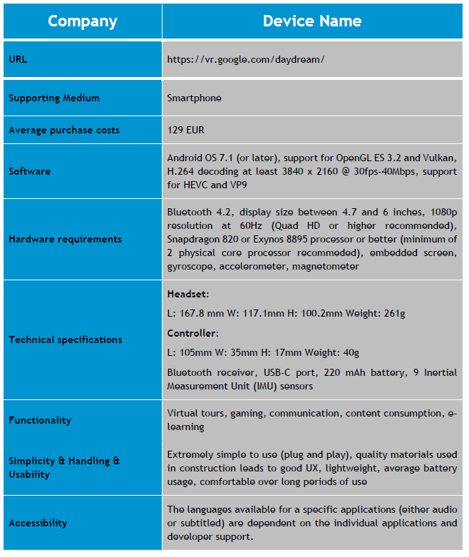
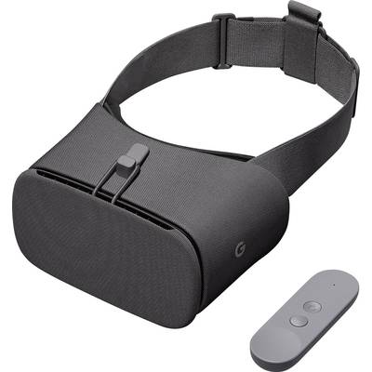
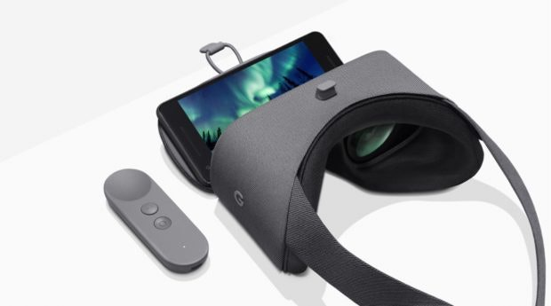
Smartphone-Based Hard- and Software
GOOGLE DAYDREAM VIEW

Slide 18
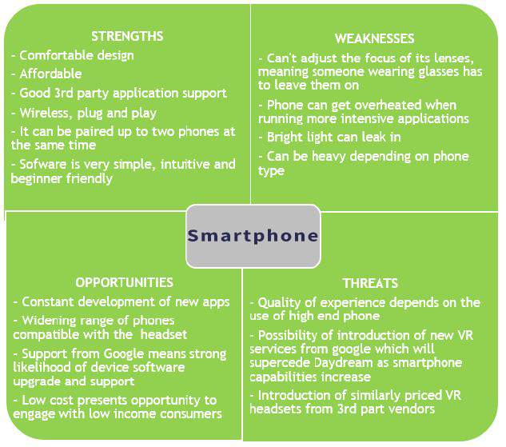
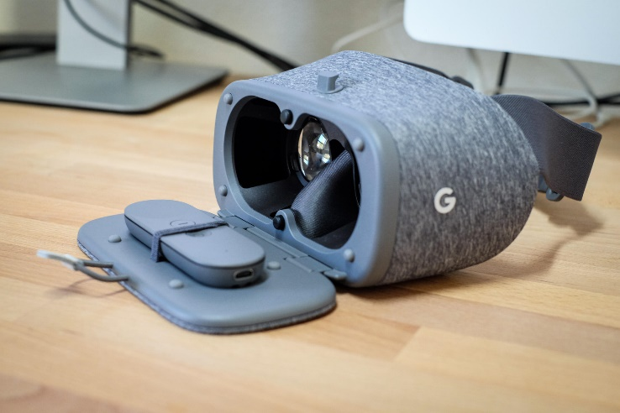
Smartphone-Based Hard- and Software
GOOGLE DAYDREAM VIEW

Slide 19
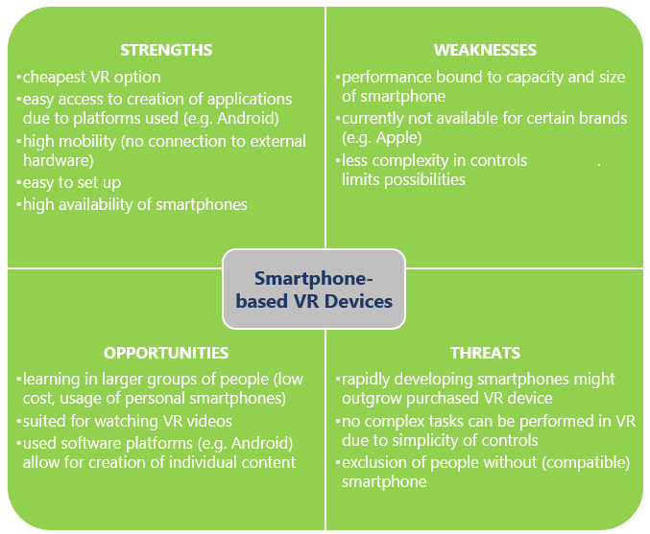
Smartphone-Based Hard- and Software - SWOT

Slide 20
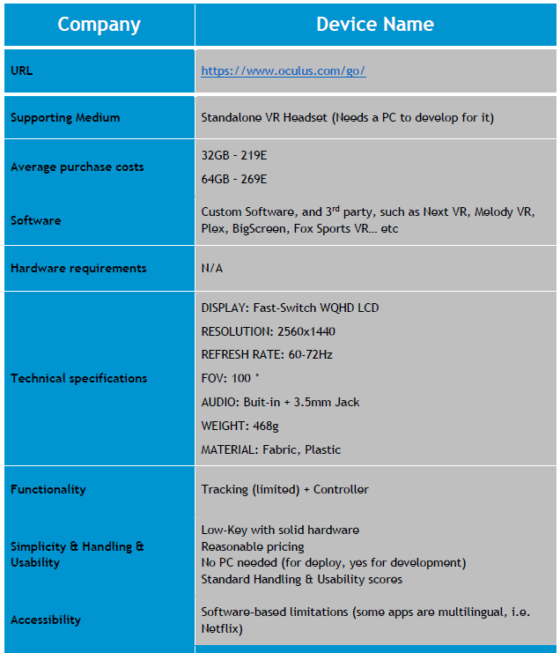
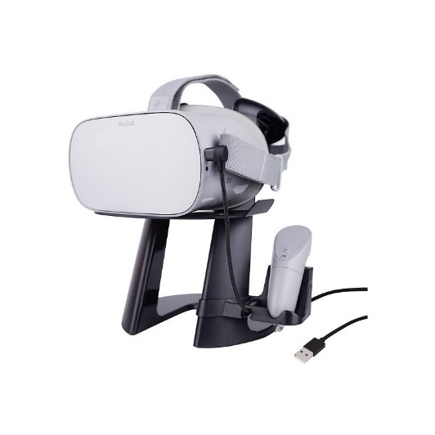
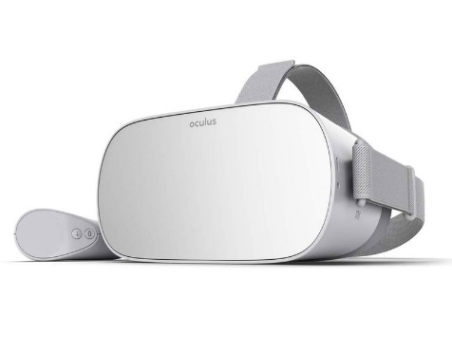
Stand-alone Hard- and Software
OCULUS GO

Slide 21
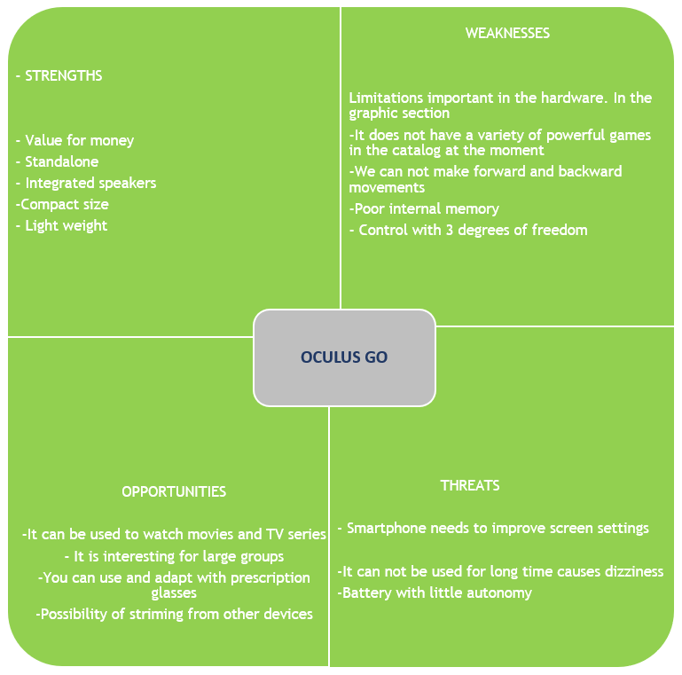
Stand-alone Hard- and Software
OCULUS GO

Slide 22
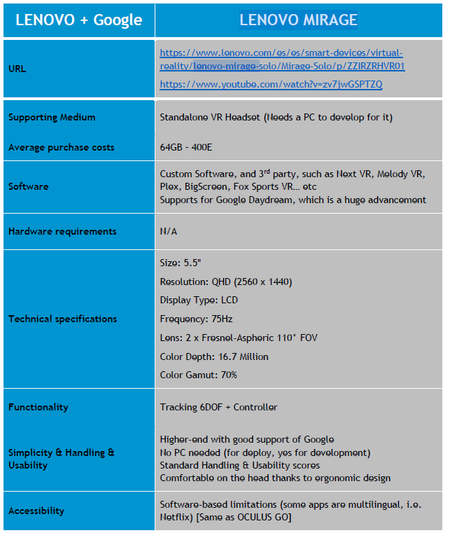
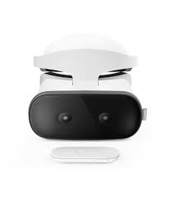
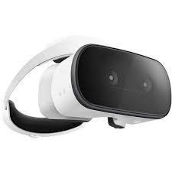
Stand-alone Hard- and Software
LENOVO MIRAGE

Slide 23
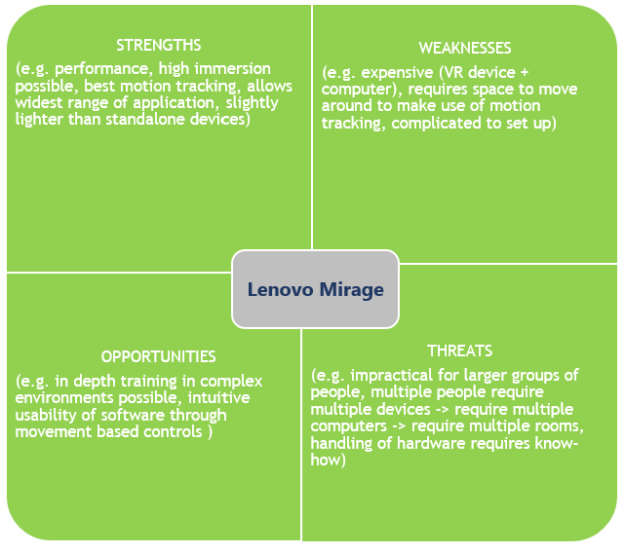
Stand-alone Hard- and Software
LENOVO MIRAGE

Slide 24
Stand-alone Hard- and Software
HTC VIVE FOCUS

Slide 25
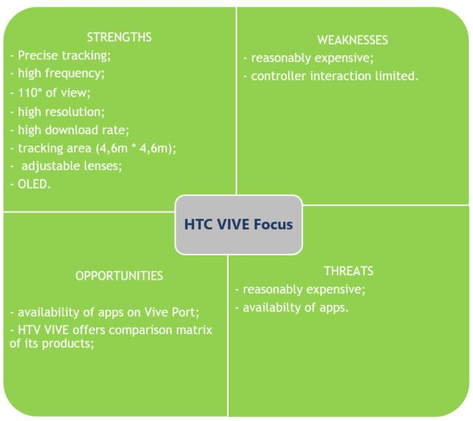
Stand-alone Hard- and Software
HTC VIVE FOCUS

Slide 26
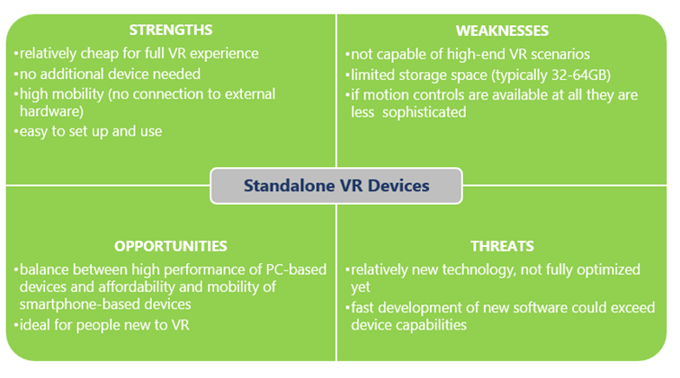
Stand-alone Hard- and Software
SWOT

Slide 27
PC-based Hard- and Software
OCULUS RIFT

Slide 28
PC-based Hard- and Software
OCULUS RIFT

Slide 29
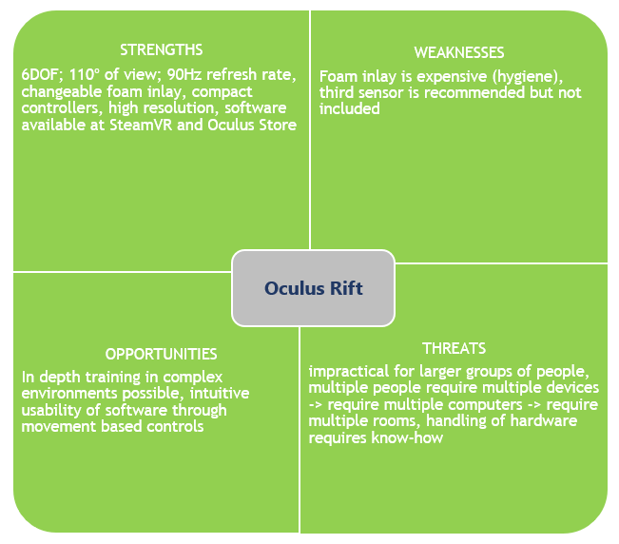
PC-based Hard- and Software
OCULUS RIFT

Slide 30
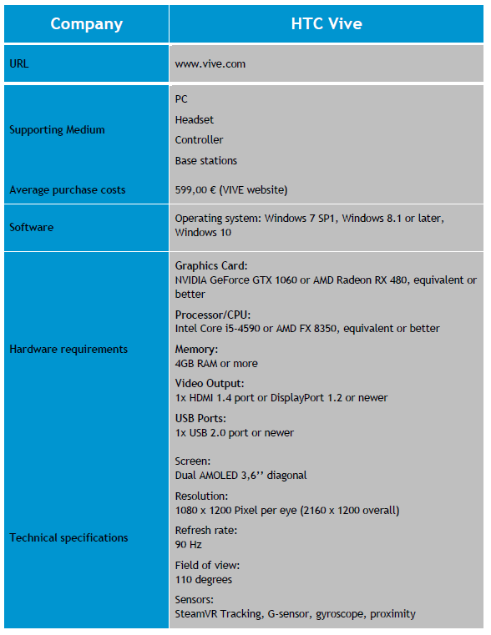
PC-based Hard- and Software
HTC VIVE

Slide 31
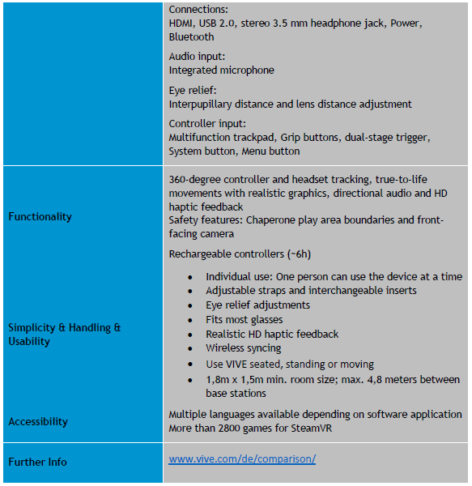
PC-based Hard- and Software
HTC VIVE

Slide 32
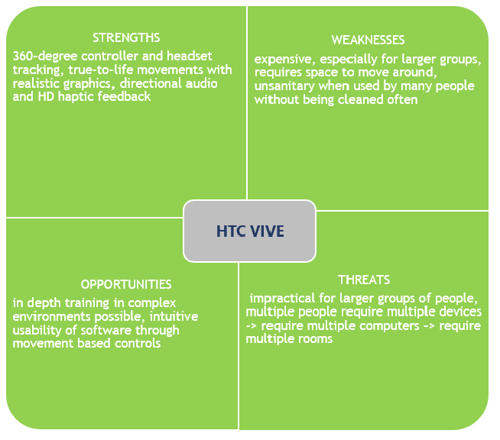
PC-based Hard- and Software
HTC VIVE

Slide 33
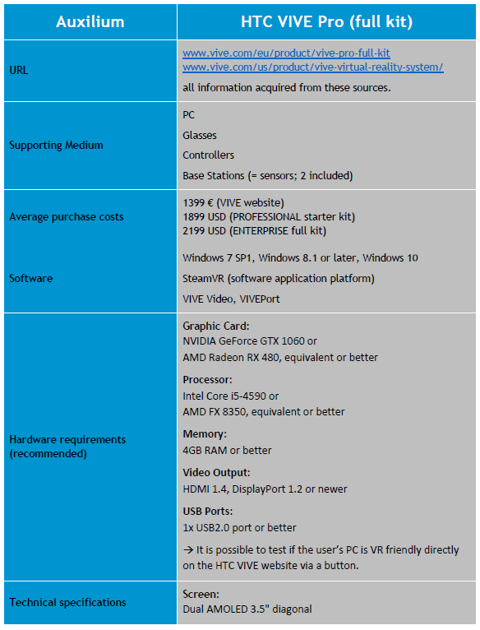
PC-based Hard- and Software
HTC VIVE PRO

Slide 34
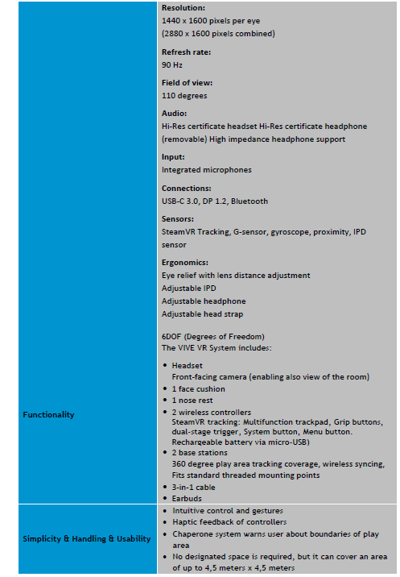
PC-based Hard- and Software
HTC VIVE PRO

Slide 35
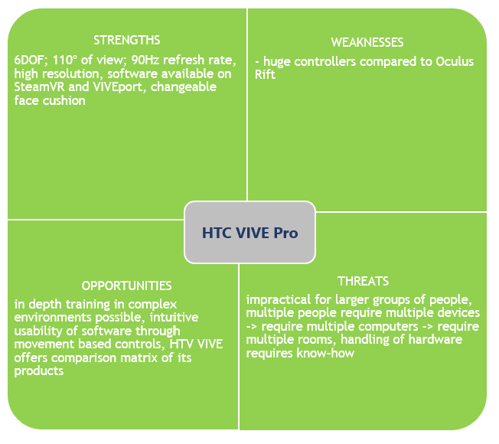
PC-based Hard- and Software
HTC VIVE PRO

Slide 36
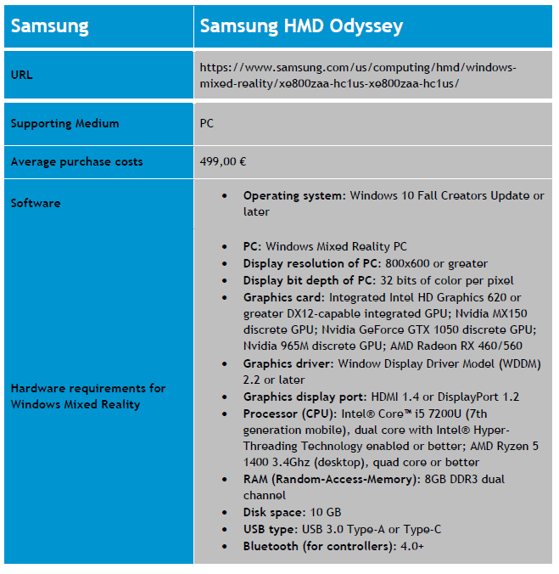
PC-based Hard- and Software
SAMSUNG ODYSSEY

Slide 37
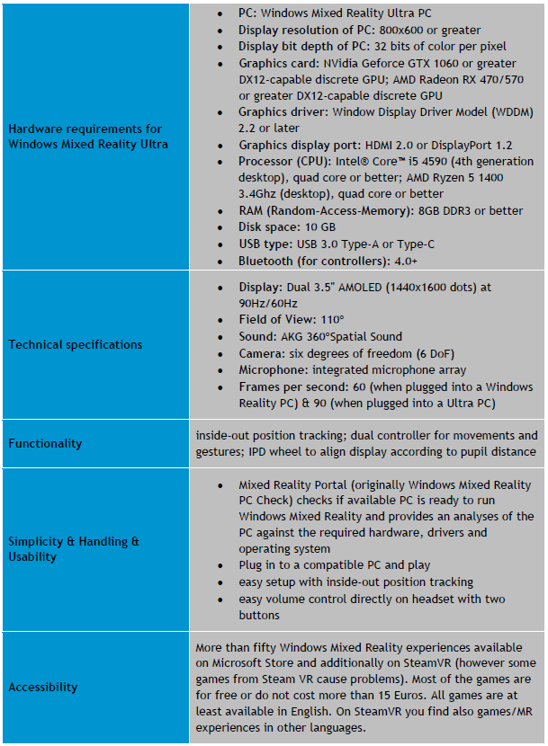
PC-based Hard- and Software
SAMSUNG ODYSSEY

Slide 38
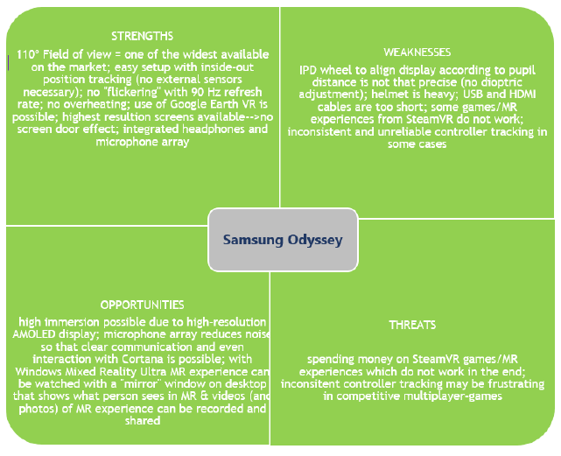
PC-based Hard- and Software
SAMSUNG ODYSSEY

Slide 39
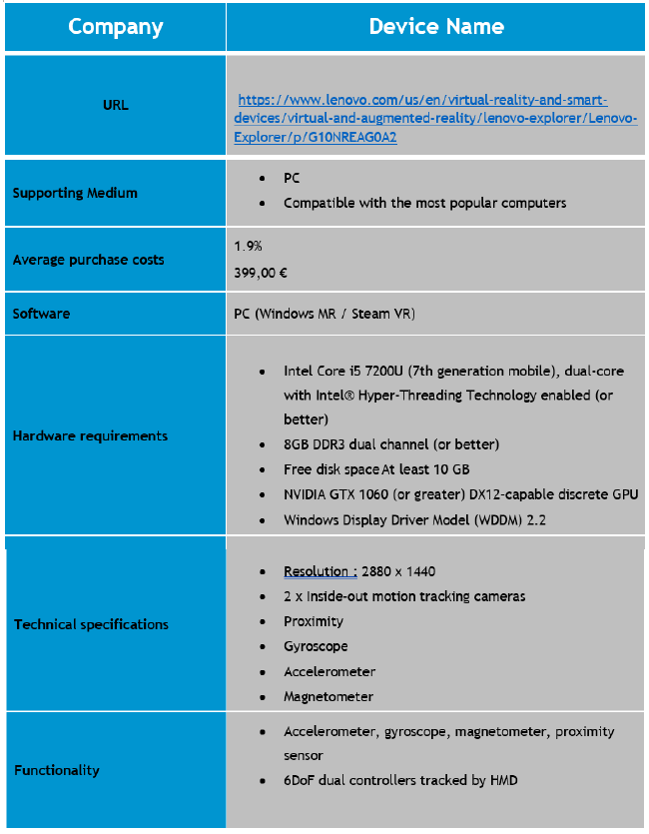
PC-based Hard- and Software
LENOVO EXPLORER

Slide 40
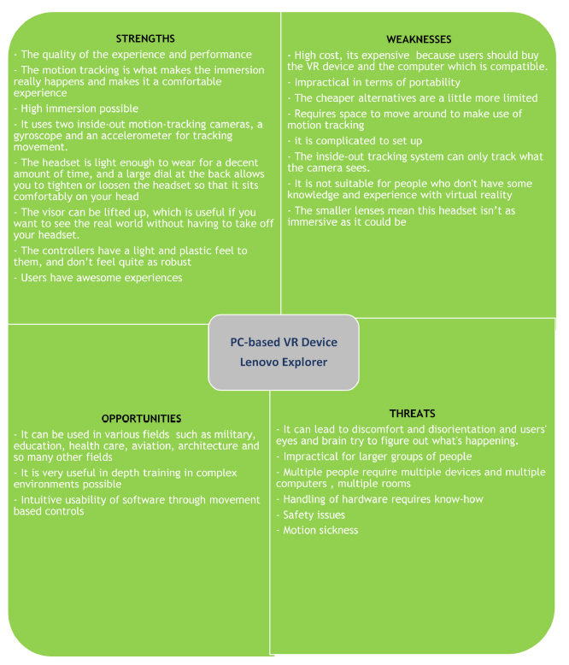
PC-based Hard- and Software
LENOVO EXPLORER

Slide 41
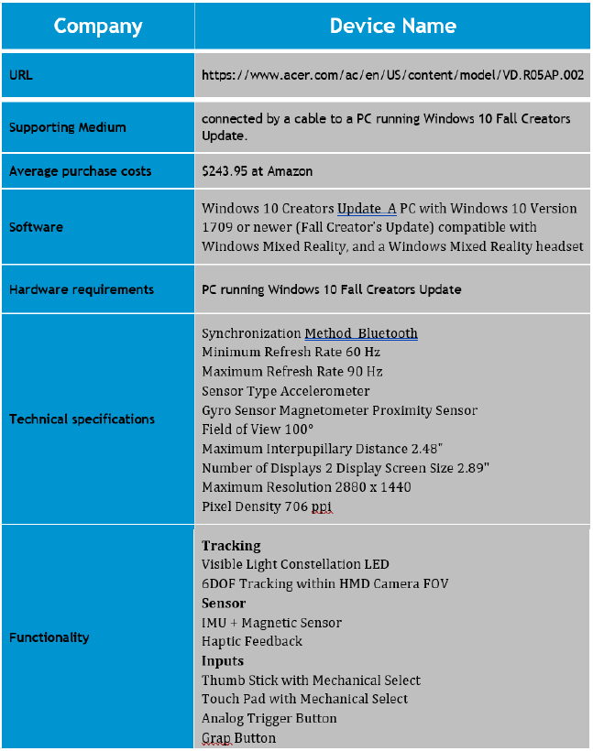
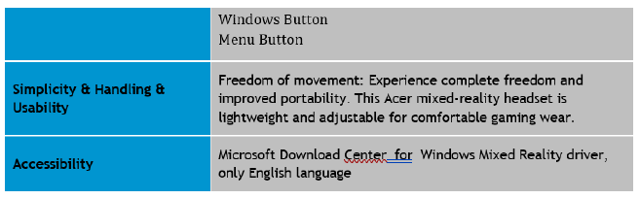
PC-based Hard- and Software
DELL VISOR

Slide 42
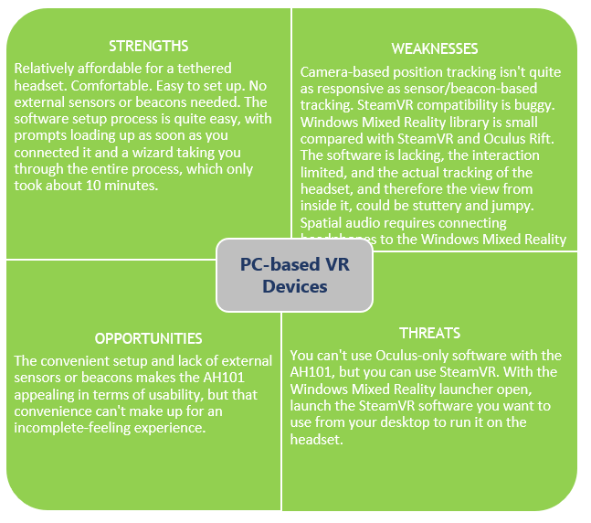
PC-based Hard- and Software
DELL VISOR

Slide 43


PC-based Hard- and Software
ACER AH10

Slide 44

PC-based Hard- and Software
ACER AH10

Slide 45

PC-based Hard- and Software
SWOT

