Slide 1
Unit 2: VR in Education & for Adult Learning

Slide 2
Overview
VR in Education
Global Comparison – State of the art
Academic Discussions
VR for Adult Learning
Overview of Academic Discussions
VR & Adult Training

Slide 3
Introductory Exercise
UNIT 2: VR in Education & for Adult Learning

Slide 4
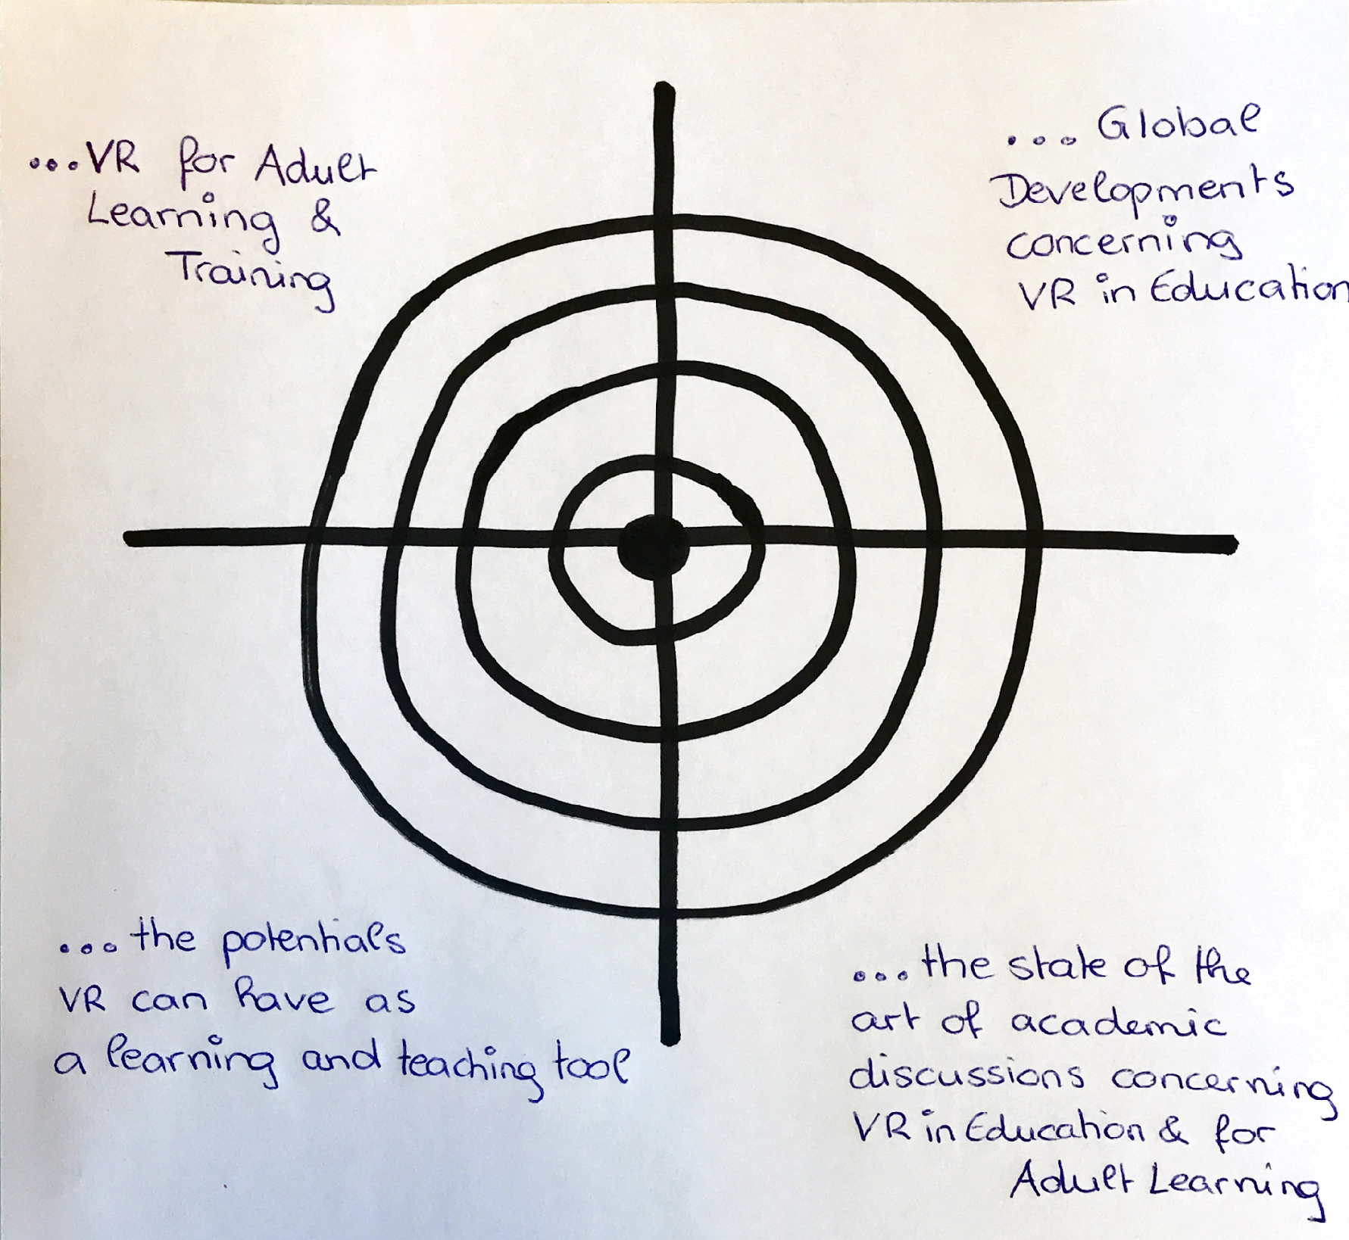
Introductory Exercise: Self-Assessment
„The Target“ for Self-Assessment
Notes:
For this introductory exercise called „The target“ a flip chart with a target drawn on it and with the aspects for the self-assessment in the corners needs to pe prepared in advance. For help, have a look at the picture on the slide above!

Slide 5
Introductory Exercise: Self-Assessment
How would you assess your own knowledge about…
…VR for Adult Learning & Training?
…Global Developments concerning VR in Education?
…the potentials of VR as a learning and teaching tool?
…the state of the art of academic discussions concerning VR in Education & for Adult Learning?
Notes:
For this exercise provide each trainee with four sticky dots and ask them to assess themselves in terms of the questions raised on the slide above.
In order to visualize their assessment, ask them to locate their dots on the flip chart prepared. Each trainee should stick one dot in each quarter of the target indicating their amount of knowledge about the aspects stated. In this context, dots located in the middle of the target indicate that the trainee already knows a lot about this aspect. In contrast, dots located on the outer ring indicate little or nearly no knowledge about the aspects at stake.
This exercise will be repeated at the end of the unit to check if the existing knowledge has increased.
If desired, you can also change the question or add further aspects of your interest.
Note: The original method is called “Die Zielscheibe” in German. Have look at erwachsenenbildung.at (2016).

Slide 6
Global Comparison
VR in Education

Slide 7
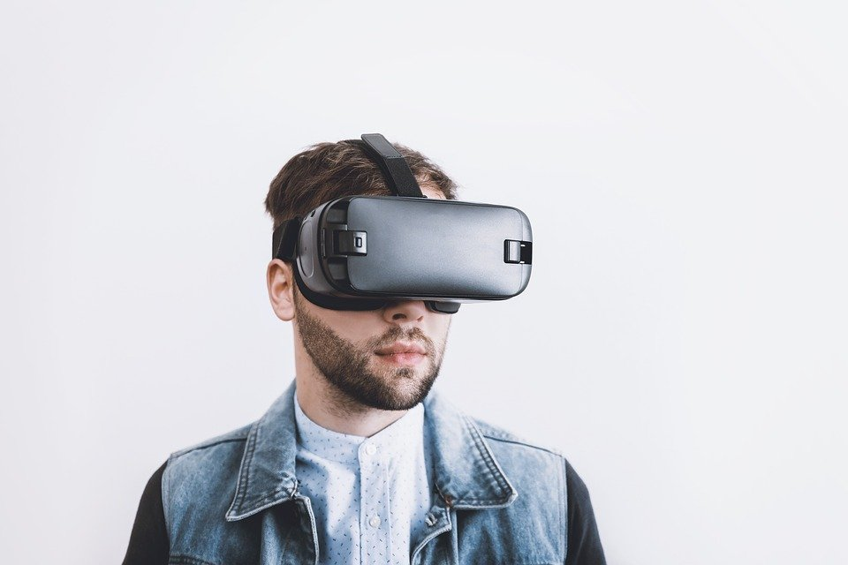
Virtual Reality
How does Virtual Reality work?
Notes:
https://www.youtube.com/watch?v=-Kovxf6g0mo

Slide 8
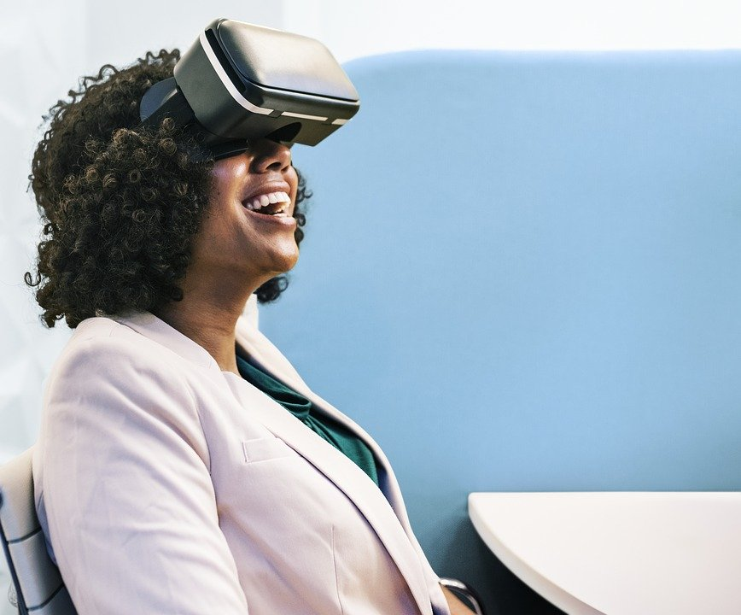
Global Comparison
In which fields is VR being effectively used for learning?
Notes:
Raise the question stated on the slide above in class and tell the trainees to lay focus on European developments. Ideally write the answers on a flip chart. Discuss them together!

Slide 9
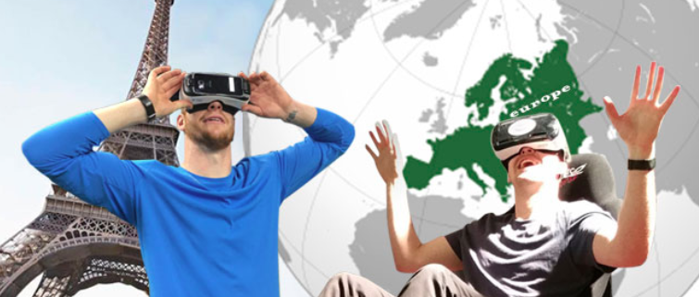
Global Comparison
Which countries do you think have a dominant role in VR for learning?
Notes:
Raise the question stated on the slide above in class.

Slide 10
The state of the art within Europe
Europe is responsible for a fifth of global VR market and thus is one of the major players on the VR market along with Asia and North America (CBI, 2019).
European VR frontrunner countries are: France, UK, Germany, Netherlands, Sweden, Spain and Switzerland.
Many European innovative start-ups, companies and also universities, are working on the development of VR technologies and software that enable the use of VR in different application areas.
Notes:
You can introduce this slide with the question: What do you know about the developments of VR in Europe?
Notes for trainers: you can also mention: However, over the last years, emerged also important VR initiatives in Finland, Denmark, Estonia, Italy, Poland, and Greece (Bezegová, Ledgard, Molemaker, Oberč, & Vigkos, 2017).
You can also make a graph based on the above info

Slide 11
The state of the art within Europe
How is VR used for learning?
VR as a teaching tool
Making VR lectures as part of the curriculum
Visit places, monuments, festivals, museums, galleries
Facilitates learning experiences and develop skills:
Examples: public speaking VR application

Slide 12
VR learning and development in Asia (Japan- China)
In terms of VR topics, Asia is active in content creation, however, for cultural and language reasons, it is mainly focused on the Asian market.
The Japanese VR market has a lot of strong players in the gaming field and VR has largely been used in Japan for entertainment purposes.
Notes:
Additional info: During the last years the Asian VR market has been growing at a high rate also driven by the support of local governments .

Slide 13
VR learning and development in Japan
Outside gaming, there are also Initiatives in education according to EU-Japan Centre for Industrial Cooperation (https://www.eu-japan.eu/).
So far, VR initiatives in Japan applied in a wide variety of industries, such as medicine, tourism, retail, and manufacturing.
VR companies in Japan are working on developing VR technologies for industrial solutions and creating opportunities to commercialize those technologies.

Slide 14
VR learning and development in China
It is a fact that there is amazing growth and in the next five years, China could dominate the VR market (Merel, 2018). In China, there are many startups that are working on software development in the area of education and workplace.
The Chinese government has really committed to facilitating VR growth within the country, emphasizing the innovation and considering VR as a key technology for the development of the country (Dayan, 2017).

Slide 15
VR learning and development in China
The interest of China, regarding the VR, focuses on some key areas, like:
Education: to make learning more efficient and entertaining. Schools in China already use virtual classes and virtual examinations;
Culture: to promote tourism and to preserve important historical places and monuments virtually forever.
Health: The use of VR for doctors’ training purposes and also for people’s treatment.
Business: VR creates new kind of e-commerce

Slide 16
VR learning and development in the USA
The United States of America (USA) has a leading position in the global VR market.
VR software development is the main activity of several VR companies situated in the United States.
A recent report by Higher Education Technology Company reports that almost half of US Colleges use VR technologies.

Slide 17
VR learning and development in the USA
Higher Education institutions are investigating a range of uses for VR technology, from offering virtual lab facilities for remote learning students, to simulated surgical procedures to train medical students.
According to the report, the VR market will continue to increase with lower-cost alternatives and portable devices, such as Google Cardboard and Oculus Go (Hills-Duty, 2018).

Slide 18
Exercise: State of the art of VR learning inside & outside of Europe
Exercise:
Go together in pairs or groups of three.
Find at least three similarities and three differences concerning the developments of VR learning inside and outside of Europe!
Refer to the countries addressed in the presentation before!
Notes:
Introduce the exercise on the slide above and give the trainees at least ten minutes for the task.
Tip: For support, leaners could be provided with the relevant parts of the sections 3.1, 3.2 and 3.3 of the Viral Skills Compendium which refer to the developments in Europe, in Asia (Japan & China) and the USA.
After that, ask the trainees to share their results in class.
Alternatively, you could also prepare a flip chart with a table. Trainees could be asked to add their results in the table. Afterwards findings could be discussed in class.

Slide 19
Academic Discussions
VR in Education

Slide 20
VR’s Potentials for Learning
What potentials can you think of VR might have in terms of learning in general?
Notes:
Let the trainees brainstorm with regard to the question on the slide above and collect their answers on a flip chart.
Alternatively to the flip chart, you could also use the digital pinboard „Padlet“.
After that, present the potentials and the unique characteristics of VR as a learning tool on the following slides and refer to the ideas and results collected in this exercise.

Slide 21
Insights into VR’s Potentials for Learning
According to studies and academic discussions learning in VR…
…increases learners’ motivation
…is highly engaging
…can increase learners’ level of attention by 100 percent
…allows learning by mistakes in a safe environment
…can increase memory capacity
…can facilitate understanding of complex learning contents and concepts
© By PresentationGO.com
Notes:
Alternatively to this slide you could also write those aspects on small (maybe coloured) sheets of paper and pin them on the flip chart where potentials got collected.

Slide 22
Insights into VR’s Potentials for Learning
VR can make complex learning content more easily understandable by using didactic reduction.
Didactic reduction can imply…
…to make use of time-compression or -stretching
…to hide irrelevant details of contents
…to make interdependent factors visible
…to manipulate the relative size of objects
Example: to shrink the solar system
Notes:
For more info you can also have a look at Klampfer (2017) p. 19-20 and Kritzenberger (2005) p. 104.
Kritzenberger, H. (2005). Multimediale und interaktive Lernräume. München: Oldenbourg Wissenschaftsverlag.

Slide 23
Unique Characteristics of VR as a Learning Tool
Multi-sensory Interaction with a three-dimensional space
🡪Distinguishes VR form other learning tools according to Schwan & Buder (2002)
Three-dimensional visualization of learning content
Interaction with objects and people in the virtual world
Multi-sensory nature:
Allows to experience learning content visually, auditorily and sometimes even haptically
Notes:
For more info you can also have a look at Christou (2010).

Slide 24
Further Characteristics of VR as a Learning Tool
The VR-Worlds may be…
…realistic or imaginary
…macroscopic or microscopic
…based on imaginary dynamics or on realistic physical laws
„The multitude of scenarios that Virtual Reality can be used to depict make it broadly applicable to many education fields“ (Christou, 2010, p. 229)

Slide 25
Virtual Realities as Virtual Learning Environments (VLEs)
According to Schwan & Buder (2006) Virtual Realities can be differentiated based on their…
…didactical approaches,
…opportunities for action they provide for learners and
…their learning contents.
Schwan & Buder distinguish between four different virtual learning environments (VLEs):
Explorative VLEs
Experimental VLEs
Constructive VLE
Virtual Training Environments
Notes:
Note:
The VLEs are translated into English from the German article of Schwan & Buder (2006). Find beneath the original terms:
Virtual Learning Environments = Virtuelle Lernwelten
Explorative VLEs = Explorationswelten
Experimental VLEs = Experimentalwelten
Constructive VLEs = Konstruktionswelten
Virtual Training Environments = Trainingswelten

Slide 26
Virtual Realities as Virtual Learning Environments (VLEs)
According to Weise & Zender (2017) to the four VLEs the VLEs of Exposition should be added.
Klampfer (2017) also mentions Social VLEs.
Therefore Virtual Realities can serve as…
Explorative VLEs
VLEs of Exposition
Experimental VLEs
Constructive VLEs
Virtual Training Environments
Social VLEs
Notes:
Note:
The term “VLE of Exposition” is translated into English from the German article of Weise & Zender (2017). The original term for VLEs of Exposition is “Expositionswelten”.

Slide 27
Virtual Realities as Virtual Learning Environments (VLEs)
What kind of VR Learning Software/Apps do you know?
Write them down!
Try to relate these apps/software to the six different VLEs which will be described more detailed in the following!
Notes:
Provide the learners with some (maybe coloured) slips of paper where they can write down their examples of VR Learning Software/Apps. Give ideally one or two examples yourself so that the trainees know what to do. Give them a few minutes for this task and then continue with presenting the VLEs.

Slide 28
Virtual Realities as Explorative VLEs
Explorative VLEs…
…allow Virtual Teleportation
…as they can "transport“ learners to places, monuments, galleries, museums, etc.
…can enhance Geography, Biology and Art Education
…extend boundaries of traditional classes
…as they also allow to visit places too far away, too dangerous or not even accessible without VR

Slide 29
Explorative VLEs from a Pedagogic Point of View
Explorative VLEs…
…give learners the control over the learning process
…as they allow learners to actively discover and explore learning contents at their own pace and order
…are especially suitable for learners with intrinsic motivation
Learning Objective
To impart knowledge about static facts

Slide 30
Virtual Realities as VLEs of Exposition
VLEs of Exposition…
…are similar to Explorative VLEs, without opportunity to free exploration of learning content
…provide a more passive learning experience
360° videos and/or photos
Example: VR App „Titans of Space“

Slide 31
VLEs of Exposition from a Pedagogic Point of View
VLEs of Exposition…
…are more structured and guide the learners
…are especially suitable for learners with less intrinsic motivation and little prior knowledge of learning contents
Learning Objective
To impart knowledge about static facts

Slide 32
Virtual Realities as Experimental VLEs
Experimental VLEs…
…are based on virtual simulations
…allow learners to influence objects and their properties and to observe the consequences
Example: Virtual labs for Chemistry Classes

Slide 33
Experimental VLEs from a Pedagogic Point of View
Experimental VLEs…
…foster learning through a scientific and experimental approach
…as they provide learners with a virtual environment to formulate and examine hypotheses
Learning Objective
Understanding of causal relationships

Slide 34
Virtual Realities as Constructive VLEs
Constructive VLEs…
…allow learners to build virtual objects or whole virtual worlds
Example: VR App „Rumpus“

Slide 35
Constructive VLEs from a Pedagogic Point of View
Constructive VLEs…
…base learning on a deductive approach
…as learners shall elaborate concepts in advance which shall be evaluated afterwards by building the VLEs
…require prior knowledge of learning content
Learning Objective
Understanding of complex concepts

Slide 36
Excursion: Learning Theory
What Learning Theory might be supported regarding the VLEs described?
Notes:
Raise the question stated on the slide above in class.

Slide 37
Excursion: Constructivism
Constructivism…
…is often stated as the ideal learning theory to provide a theoretical basis for VLEs
„…is a theory of knowledge acquisition that states that humans construct knowledge by learning from their experiences” (Christou, 2010, p. 229)
VLEs allow active learning from experience due to VR‘s characteristic of multi-sensory interaction.
Notes:
For more info have a look at Christou (2010)!

Slide 38
Excursion: Immersion
Immersion…
…describes „the subjective feeling of existing completely in the virtual world („being there“)“ (Klampfer, 2017, p. 5)
… is often referred to as having “a sense of presence” in the VLE (Sherman & Craig, 2003, p. 9)
Immersion is beside the multi-sensory perception and interactivity one of the sources from which the experiential nature of VR derives.
Notes:
For more info have a look at Christou (2010).
Sherman, W. R., Craig, A. B. (2003). Understanding Virtual Reality: Interface, Application, and Design. San Francisco, CA: Morgan Kaufmann.

Slide 39
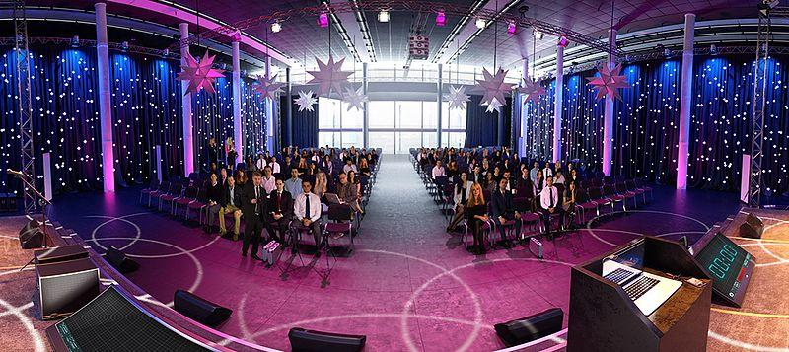
Virtual Realities as Virtual Training Environments
Virtual Training Environments…
…are used to simulate realistic (training-) scenarios
Example: VR App „Virtual Speech“
for soft skills training e.g. presentation skills training
Picture by Fasicle. License: CC BY-SA 4.0

Slide 40
Virtual Training Environments from a Pedagogic Point of View
Virtual Training Environments…
…allow trainers more than e.g. Explorative VLEs to control learning processes
…and allow therefore less self-directed learning
Learning Objective
Acquisition of action-oriented skills

Slide 41
Virtual Realities as Social VLEs
Social VLEs…
…allow several learners to visit one and the same VLE at the same time and to interact with each other
…allow to meet and learn from people on the other side of the world
…foster collaborative learning
…can be used for language learning, project work, collaborative problemsolving, etc.
…may become important in terms of remote and blended learning
Notes:
For more info have a look at Klampfer (2017) p. 17-18.

Slide 42
Virtual Realities as Virtual Learning Environments (VLEs)
What kind of VR Learning Software/Apps do you know?
Relate these apps/software to the following VLEs & their didactical approaches!
Explorative VLEs
VLEs of Exposition
Experimental VLEs
Constructive VLEs
Virtual Training Environments
Social VLEs
Notes:
1) Ideally prepare a flipchart in advance with the different VLEs written on it.
The flip chart could be either organised like the slide above but alternatively also show the topic in form of a mind map having the term „Virtual Learning Environments“ located in the middle and the different VLEs added on branches around of it.
2) Let the trainees pin their examples to or beneath the different VLEs.
3) Go through the examples and let the trainees explain their decisions.
4) Examples and reasons for decisions should then be discussed in class.
Tip 1: Before this exercise, summarizes together with the trainees the core points heard about the VLEs.
Tip 2: Prepare some examples in advance in case the trainees don‘t know any examples on their own!

Slide 43
VR in Education– Aspects to consider…
…from a Didactical Point of View
The successful integration of VR into educational contexts does imply various aspects to be considered.
According to Schwan & Buder (2006) sensible use of Virtual Reality in education implies to coordinate the use of VLEs with…
…learning objectives,
…learning contents and the
…VR hardware available.
Notes:
Explanatory info:
>The decision which VLEs should be used for one’s educational contexts depends on the learning contents as well as on the learning objectives which should be achieved.
>Further has to be considered that not every hardware allows the same degree of interaction. E.g. training simulations with a Smartphone-based VR Hardware will be more limited in interaction than training simulations with a PC-based VR Hardware.

Slide 44
VR in Education– Aspects to consider…
…from a Didactical Point of View
VR should support rather than replace traditional learning and teaching methods
According to Schwan & Buder (2002)…
…especially learning processes in Constructive and Experimental VLEs should be embedded in course schedules and supported by trainers.
…in order to avoid misconceptions concerning learning contents feedback on learning processes in VR is essential
…and can be supported by virtual avatars
Notes:
Additional info: VR can be the ideal tool to enhance knowledge acquisition, but can‘t impart social competences like face-to-face settings (see Zobel, Werning, Metzger, & Thomas 2018).
Zobel, B., Werning, S., Metzger, D., & Thomas, O. (2018). Augmented und Virtual Reality. Stand der Technik, Nutzenpotenziale und Einsatzgebiete. In C. d. Witt, & C. Gloerfeld (Eds.), Handbuch Mobile Learning (pp. 101-123). Wiesbaden: Springer VS.

Slide 45
VR in Education– Aspects to consider…
…include Challenges
In the past various issues concerning VR where discussed including...
…critical usability
...high costs of hardware and
…lack of realism of VR software
Today, not only VR hardware is more affordable and efficient but also VR software is developing at a steady pace.
Notes:
For more info have a look at chapter 2.1.7 of the Viral Skills Compendium.

Slide 46
VR in Education– Aspects to consider…
…include Challenges
Simulator Sickness is the only issue which is still discussed and investigated in academic fields
According to Klampfer (2017) increased occurrence is connected to a combination of…
…individual factors, such as experience with VR, and
…technical factors, such as the speed during the VR navigation
In order to avoid the sickness these factors as well as the type of the VR application should be considered before any educational use of VR
Notes:
For more info have a look at chapter 2.1.7 of the Viral Skills Compendium.

Slide 47
Overview of Academic Discussions
VR for Adult Learning

Slide 48
Academic Discussion regarding Virtual-Reality-Learning
1970s first VR headset was created
first discussions/empirical studies concerning Virtual-Reality-Learning go back to 1990s
Examples:
„A Conceptual Basis for Educational Applications of Virtual Reality“ (Winn, 1993)
„Fourteen Propositions about Educational Uses of Virtual Reality“ (Winn & Jackson, 1999)
back then, many constraints prevented the adoption of VR by the general public
today, VR is finally mature enough to be integrated in educational contexts
Notes:
Additional info: Most of the propositions of Winn & Jackson (1999) are still highly topical.
For more info have a look at the introduction of chapter 2 & 2.1 of the Viral Skills Compendium!

Slide 49
Academic Discussion regarding VR in Adult Education
little literature can be found discussing/investigating VR in adult education
recent discussions show: interest is increasing
“Virtual Reality” is one of the most discussed key terms 2018 in the field of further education
..according to a Trend analysis on behalf of the German Institute for Adult Education
emphasis of discussions lies on the development of didactical concepts and practical guidelines
Notes:
For more info have a look at chapter 2.1.1 of the Viral Skills Compendium!

Slide 50
Academic Discussion regarding VR for Adult Learning
“Virtual Reality for Training and Lifelong Learning”(Mellet-d'Huart , 2009)
…is one comprehensive article about adult learning and VR published in France
emphasis on unique advantages VR has for training adults
VR enables training which would in real life…
...either too dangerous,
…too expensive or
…simply unachievable
Notes:
For more info have a look at chapter 2.1.2 of the Viral Skills Compendium!

Slide 51
Academic Discussion regarding VR for Adult Learning
a lot of papers address VR for adult training
…according to a literature review on immersive Virtual Reality in Education (Freina & Ott, 2015)
VR training simulations are proven effective in a variety of fields including the…
…military sector
…medical fields
…industrial/production sector
…transportation
Notes:
For more info have a look at chapter 2.1.2 of the Viral Skills Compendium!

Slide 52
VR & Adult Training
VR for Adult Learning

Slide 53
VR’s Potentials for Adult Training
VR as…
…resource-saving learning medium
..a safe environment
…a cost-effective learning and teaching tool
Notes:
For more info about VR & Adult Training have a look at chapter 2.1.2 and chapter 2.1.3 of the Viral Skills Compendium!

Slide 54
VR for Adult Learning
For which purposes and for which fields can VR be considered as suitable learning and teaching tool in adult education?
Notes:
Summarizes together with the trainees the key points of the whole unit by answering and discussing the question stated above.
Before starting the evaluation and feedback exercise (see next slide), ask for open questions!

Slide 55
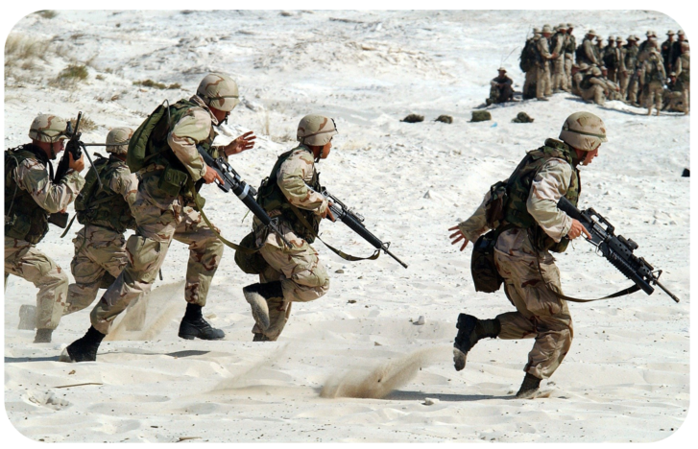
Adult Training in the Military Sector
Notes:
Text: Regarding VR training in the military sector VR provides a safe training environment for role playing and for training operations.
In this context you could show the following video (or parts of it) which is about the “Dismounted Soldier Training System“ which was in 2012 one of the most advanced military training systems and demonstrates the potential of VR in the military sector: https://www.youtube.com/watch?v=NND7Hk5fYdI
Alternative or additional suggestions:
>Virtual Reality: The Future Of Military Training (2016) (first 3 ½ min) 🡪Mixed Reality: https://www.youtube.com/watch?v=i6pEbpNM1Q4
>NYPD using VR to train for active shootings and real-life scenarios (2019) (~5 min): https://www.youtube.com/watch?v=VZyhQZSTIGQ
For more info about VR & Adult Training have a look at chapter 2.1.2 and chapter 2.1.3 of the Viral Skills Compendium!

Slide 56
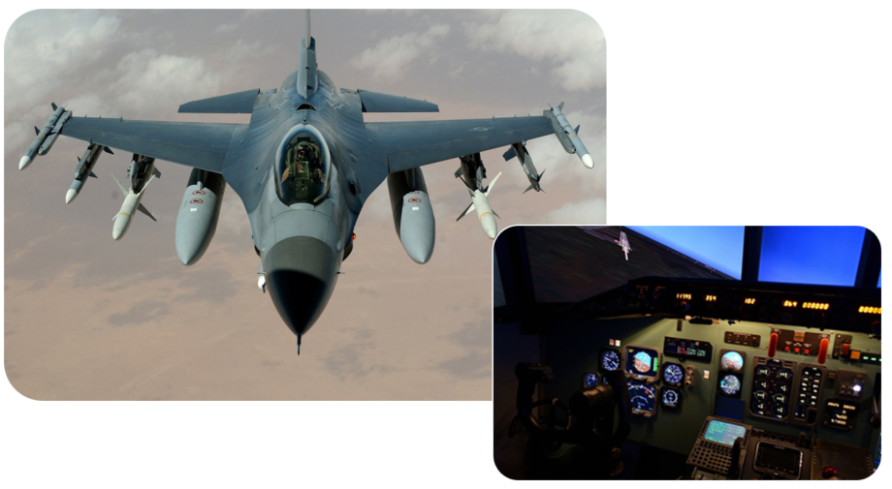
Adult Training in the Transportation
Notes:
Text: Regarding transportation VR provides a safe training environment e.g. for flight simulations (which is often connected with the military sector), but also for driving simulations.
For more info about VR & Adult Training have a look at chapter 2.1.2 and chapter 2.1.3 of the Viral Skills Compendium!

Slide 57
Adult Training in Medicine
Notes:
Text:
VR has been widely used at very different levels. Starting from nurse education in a collaborative immersive system, medical training in a virtual hospital, simulation of surgical procedures and training with expensive instruments like endoscopes. In this context, one of VR’s potential lies in the replay function. It allows VR-training situations to be repeated as often as required and this even without risks to patients or damaging medical tools.
For more insight how VR for medical training could look like, the following video or an excerpt of it could be shown: https://www.youtube.com/watch?v=LcD1VgOljLg
For more info about VR & Adult Training have a look at chapter 2.1.2 and chapter 2.1.3 of the Viral Skills Compendium!

Slide 58
Adult Training in the Industrial/Production Sector
Notes:
Text:
Regarding industrial training VR supports learning to operate, maintain or repair unavailable machines and equipment as well as training of situations, where conventional on-the-job learning is impossible due to both the risks from accidents and damaging tools. Consequently, VR allows even training and rehearsal of emergency situations and skill acquisition of hazardous tasks.
For more insight into the potentials of VR for training workers, the following video or an excerpt of it could be shown. Focus is laid on safety training for workers: https://www.youtube.com/watch?v=Rnk_akgSjqg
Alternative or additional suggestions:
The following video can provide an insight how a motor maintenance training could look like in VR: https://www.youtube.com/watch?v=dq2RSlslQcU
The following video can provide an insight how a „High Voltage Switching Training“ could look like in VR: https://www.youtube.com/watch?v=awSyBOOh99s
For more info about VR & Adult Training have a look at chapter 2.1.2 and chapter 2.1.3 of the Viral Skills Compendium!

Slide 59
Evaluation & Feedback
UNIT 2: VR in Education & for Adult Learning

Slide 60
Final Exercise: Evaluation & Feedback
How would you now assess your own knowledge after this course about…
…VR for Adult Learning & Training?
…Global Developments concerning VR in Education?
…the potentials of VR as a learning and teaching tool?
…the state of the art of academic discussions concerning VR in Education & for Adult Learning?
Notes:
For this final exercise provide again a flip chart with a target drawn on it and with the aspects for the self-assessment in the corners as you already did for the introductory exercise.
Provide each trainee again with four sticky dots and ask them again now at the end of unit 2 to assess themselves in terms of the questions raised on the slide above.
(For a more detailed description of the exercise have again a look at the notes under the slide called „Introductory Exercise: Self-Assessment“ at the beginning of the ppp!)
The results of this exercise could then be compared with the results of the introductory exercise to get an impression of the growth in knowledge. When necessary, results can be discussed in class.
Additionally, provide each trainee with a slip of paper with another target on it. Instead of a self-assessment this target should be used to evaluate Unit 2 (see next slide).
Note: The original method is called “Die Zielscheibe” in German. Have look at erwachsenenbildung.at (2016).

Slide 61
Final Exercise: Evaluation & Feedback
Notes:
Last but not least, trainees could be asked to assess the course module Unit 2 by particularly evaluating aspects like: didactical methods used, the trainer’s performance, the content addressed and time-management. These are the aspects which should be written in the corners of the target on the slip of paper (see slide above). Instead of sticking a dot on this paper trainees could draw one dot in each quarter.
For further feedback trainees could be asked to use the backside of the paper. The slips of paper are then collected by the trainer. If desired, trainees can also give directly feedback to the trainer.

