Slide 1
Unit 3
VR for low-skilled/qualified persons

Slide 2
Unit 3
VR for low-skilled/qualified persons

Slide 3
VR Apps that work for Adult Education
VIRAL SKILLS E-THEK VR apps used in adult education

Slide 4
UNIMERSIVE
Unimersiv claims to be the largest platform for VR educational experiences and applications available. The app itself provides access to a number of different learning experiences which include field trips (ISS, Acropolis of Athens etc.) which enable users to learn using VR technologies.
Currently available for free (on oculus devices only), the learning content includes VR expierences covering the following:
Human Body / Human Brain
International Space Station
Historical places
Dinosaurs
Titanic

Slide 5
UNIMERSIVE
Unimersiv - Learn through Virtual Reality - Gear VR & Oculus Rift
Forklift Training in VR - Industrial VR Training by Unimersiv
https://www.youtube.com/watch?v=bCjWlPkJ19E
https://www.youtube.com/watch?v=EXcDx1PtcZE

Slide 6
UNIMERSIVE
High potential for added value for low-skilled/qualified adults which include:
Fully guided experiences with good quality learning content throughout
Wide variety of learning experiences which motivate learners to continue with experiences
VR experiences, while immersive, are suitable for beginners
The content is learning oriented rather than focused on gaming, as such it affords learners the ability to proceed at their own pace rather than being pressured to completed set or defined tasks

Slide 7
Wonders of the World
In Wonders of the world learners visit a number of the ancient wonders including the Colossus of Rhodes, Taj Mahal and Machu Picchu. At each of these sites they can learn about its history and its historical significance to the local area and the world through an immersive and interactive experience.
While there is limited added value for low-skilled/qualified adults, the following do assist in making the application easy to engage with for all users:
Clear instructions provided throughout
The application is particularly visual in nature, offering user friendly graphics which would benefit those not used to interactive experiences or gaming
Application is learning oriented but those so through gamification rather than through traditional learning techniques
The learning process can be implemented according to the learners’ skills and abilities, allowing for engagement with a wide audience

Slide 8
Wonders of the World
Wonders of the World on Gear VR
https://www.youtube.com/watch?v=SdDqUyNic7k

Slide 9
Anatomyou
This app offers learners an opportunity to explore a variety of anatomical structures by a navigation inside the body to learn Human Anatomy in immersive virtual reality, as if they were navigating in a real minimally invasive procedure.
https://www.youtube.com/watch?v=jDXbv1heTw0

Slide 10
Anatomyou
This application might be beneficial when trying to impart knowledge about the human anatomy to low-skilled/low-qualified adult learners, especially those having difficulties with traditional learning methods, since the application provides an extraordinary perspective of various anatomical structure.
It allows the learners to immerse into the human body, explore it at their own pace and consequently might improve the learner’s understanding of the human anatomy.

Slide 11
Virtual Speech – VR Course
These award-winning training courses combine traditional online classes with VR, so that learners can practice the soft skills in immersive scenarios.
https://www.youtube.com/watch?v=RgfROqQqKkc

Slide 12
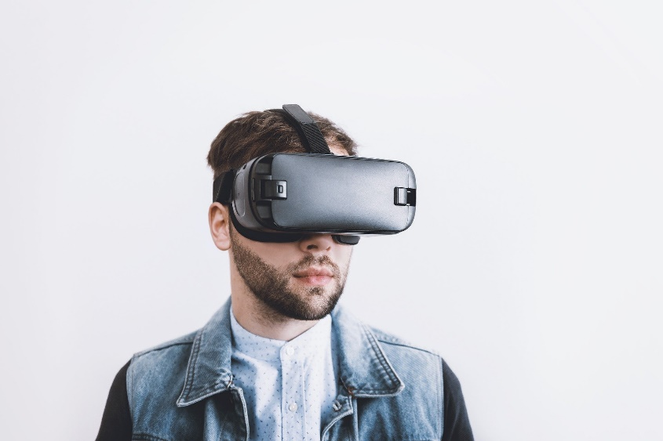
Virtual Speech – VR Course
This application might be beneficial in case of low-skilled and low-qualified adult learners, especially in case, that they are experiencing difficulties to express themselves. Embedded in a broader training setting the app might help the learner to become more confident in speaking while allowing learners to repeat training situations. Especially the application environment “Interview preparation” might be a useful scenario for this target group, particularly in case of those long-term unemployed.

Slide 13
Learn Languages VR
This application allows learners to learn a wide range of languages in a VR environment.
Languages: Arabic, Chinese (China), Czech, Danish, Dutch, English, Finnish, French (France), German, Greek, Hebrew, Hindi, Hungarian, Indonesian, Italian, Japanese, Korean, Norwegian (Bokmål), Polish, Portuguese (Brazil), Portuguese (Portugal), Romanian, Russian, Spanish (Spain), Swedish, Thai, Turkish, Ukrainian, Vietnamese
https://www.youtube.com/watch?v=I4jRqDEInIk

Slide 14
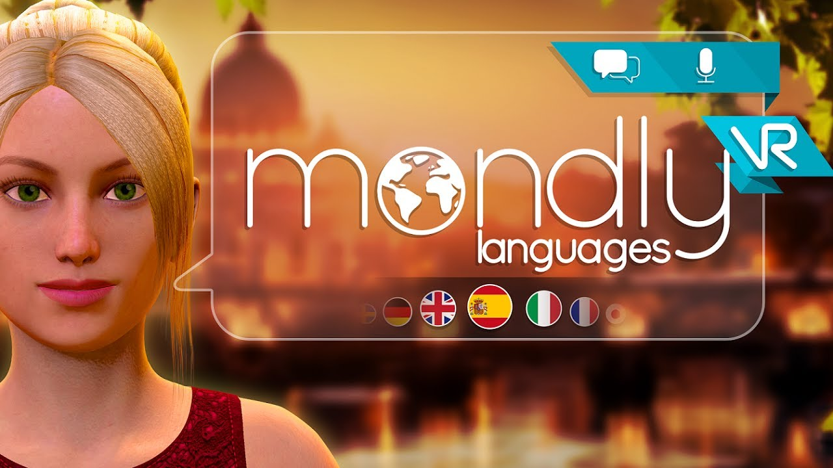
Learn Languages VR
This application might be very beneficial in terms of low-skilled and low-qualified adult learners, especially for refugees and migrants who are often challenged to become familiar with a completely new language and culture. Unlike traditional language learning the VR app allows to learn the new language in an interactive way, to practice speaking in realistic scenarios and consequently prepares the learners for everyday situations.

Slide 15
Google Expeditions
This application allows the leaners to implement expeditions to real places, historical events, space or explore the human body.
https://www.youtube.com/watch?v=3MQ9yG_QfDA

Slide 16
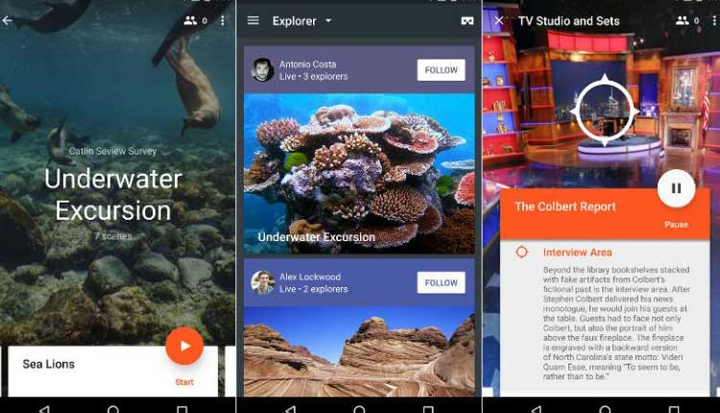
Google Expeditions
This application allows all the learners including low-skilled and low-qualified learners to gain a visual impression of places and receive information about the certain area and also to explore places which are otherwise not physically reachable.

Slide 17
International Space Station Tour VR
This application allows learners to experience the International Space Station in VR with high-quality images and learn about the inner-workings of the Space Station.
Moving between 8 modules the learners uncover over 40 key areas of the space station that serve as the living quarters and science laboratory for an international crew of astronauts and cosmonauts. It allows to gain an insiders view of what it is like to live and work on-board the longest, continually inhabited space station to orbit Earth.
https://www.youtube.com/watch?v=vnpYvz2Ledc

Slide 18
International Space Station Tour VR
Added value for low-skilled/low-qualified adult learners:
Moving through the data set in room scale VR is completely different from seeing and manipulating a 2D projection of it on a screen. Exploration is much more intuitive and the perfect depth information that you perceive feels almost like an additional input channel to the brain.
Natural movement and visualization send users down fresh cognitive pathways.

Slide 19
Google Arts & Culture
This app allows users to view artworks curated by museums from around the world. Learners step inside a virtual gallery to see works by artists like Van Gogh or Rembrandt. Learners can zoom in to see every brushstroke, and hear audio guides from expert museum curators.
https://www.youtube.com/watch?v=r3bLtn8DLYo

Slide 20
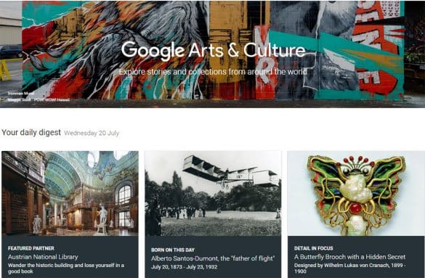
Google Arts & Culture
Added value for the low-skilled/low-qualified adults:
It allows learners to visit a collection of interesting paintings and focus on important background information
It helps to develop a rough understanding of areas and their cultural characteristics
It allows to explore paintings visually without having to physically be there

Slide 21
Ann Frank House VR
The application gives learners an opportunity to travel back to the years of the Second World War and wander trough the rooms of the Annex that housed the group of 8 Jewish people as they hid from the Nazis.
https://www.youtube.com/watch?v=HCFUuyi-lIc

Slide 22
Ann Frank House VR
This application stimulates the interest and motivation of low-skilled/low-qualified adults to be engaged in history and learn about the 2nd World War and the case of Anne Frank.
The app is very engaging and has strong gamification characteristics which will make enthusiastic all learners to be engaged with this environment and learn.
Additionally, since this is a single mode application, learners can learn in their own pace.

Slide 23
Oculus Venues
Oculus Venues allows the learners to experience concerts from the front row, sporting events, comedy shows and more. It is possible to choose from an ongoing calendar of live, immersive events in VR where there's always something new to see. Learners can join thousands of others to share the experience and meet other fans in the crowd, or watch in solo mode from a box seat high above the crowd. Oculus Venues lets them feel like they're really there for the best events in VR.
https://www.youtube.com/watch?v=4HAaMVUr16g

Slide 24
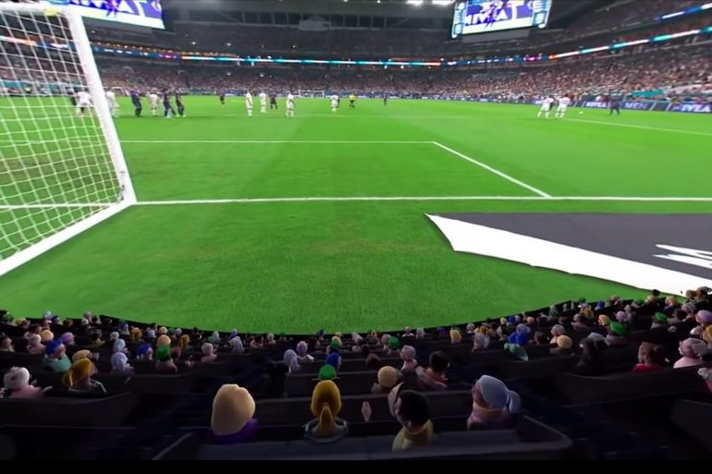
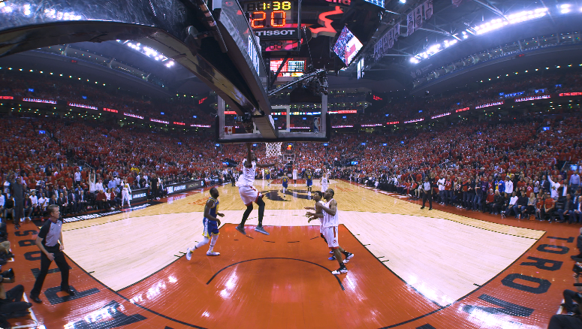
Oculus Venues
Added value for low-skilled/low-qualified adults:
This application is essentially a social platform rather than a learning platform but is valuable as it allows users to learn the first basic skills needed within a VR environment including communication, navigation and groups interaction.

Slide 25
Unit 3 VR for low-skilled/qualified persons
Thank you for the attention.

