Slide 1
Unit 4.1
Mainstreaming Viral Skills
Notes:
What is this unit about:
Main aim:
Use what you already have learned
Use VS in your professional everyday life
How will we achieve this?
Reflect what you have learned
Think about fields of application

Slide 2
Agenda
Reflection On Key Elements From Previous Units
Personal Application of VR in Training Offers
Elevator Pitch
Didactical Development of VR Lesson Plans (Working phase I)

Slide 3
What is your take-away?

Slide 4
Reflection
You have
5 Minutes for each round!
Which key points are most important to you personally?
Considering the technical aspects of VR in an educational setting
Considering the aspects relevant when working with the target group of adults and low-qualified/-skilled persons.

Slide 5
Personal Application of VR in Training Offers
Answer the reflection questions in the handout

Slide 6
Elevator Pitch

Slide 7
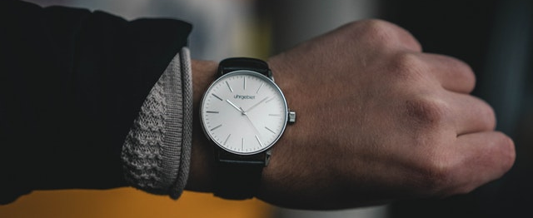
Elevator Pitch
Convince your employer, your funding partner/policy maker or your target group why the use of VR would be beneficial to achieve learning goals!
You have only
60 seconds to make your point!

Slide 8
Elevator Pitch
60 seconds time
Descripe your VR-Ideas
Convince!
Attention
Interest
Desire
Action

Slide 9
Didactical Development of VR Lesson Plans

Slide 10
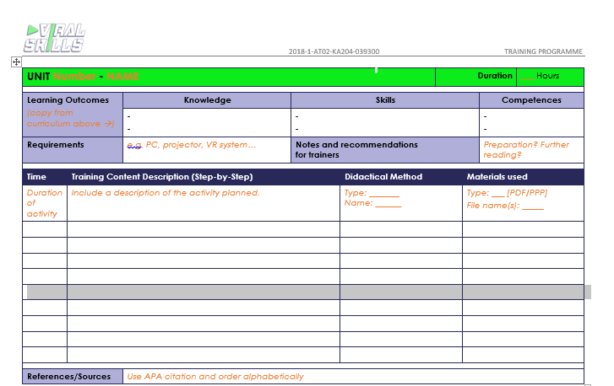
Lesson plan template
You can use this!

Slide 11
VR Lesson Plan
Find a topic you are interested in
Professional or individual context
Create an lesson plan with VR about this

Slide 12
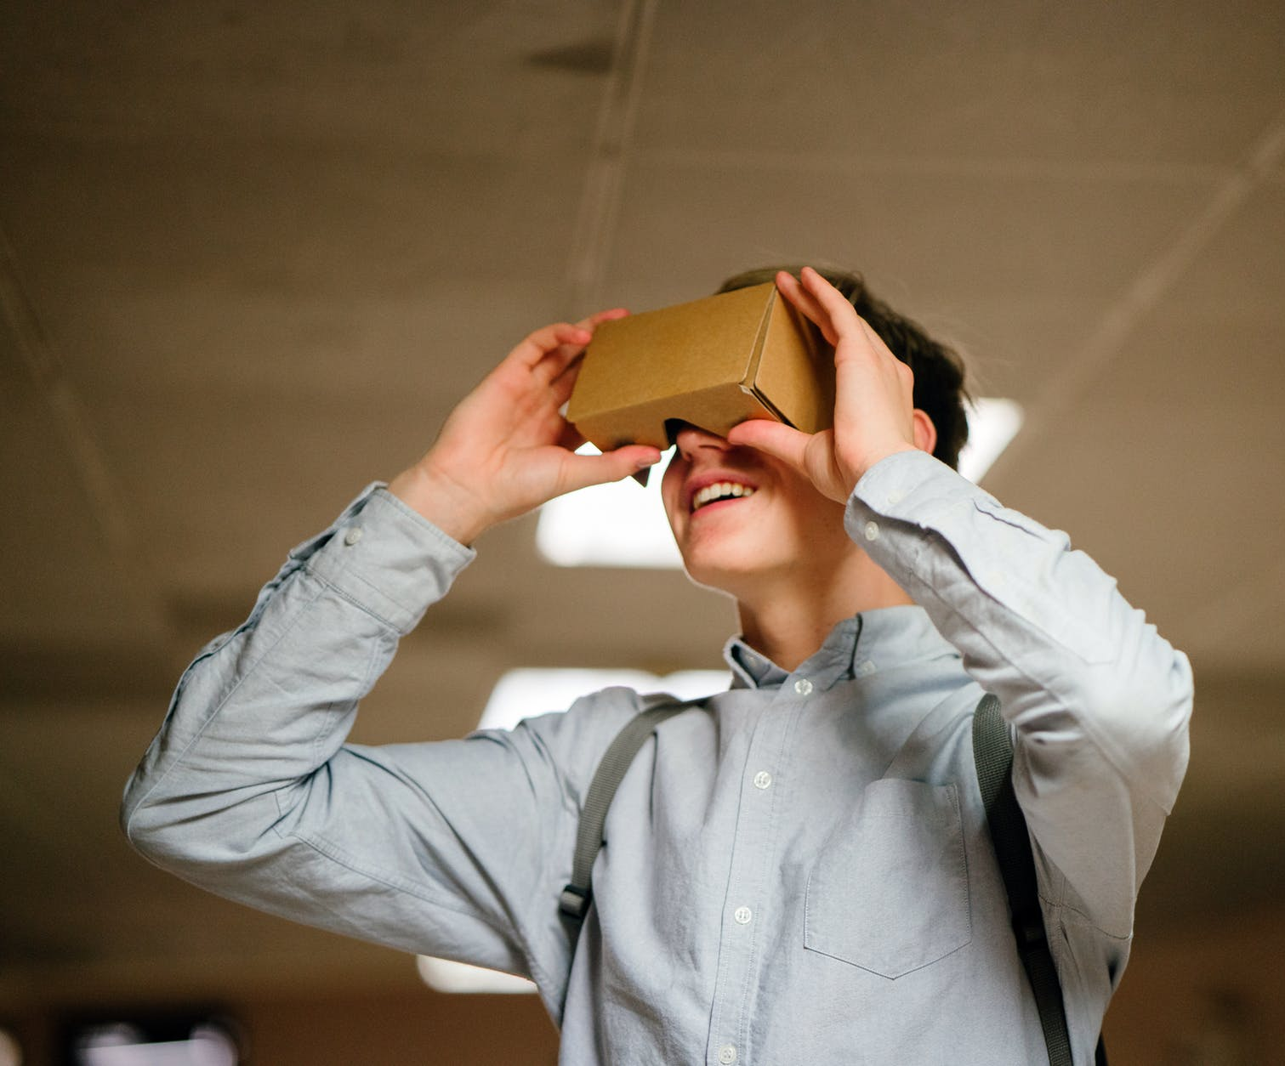
Time for the VR Lesson Plan
Today you have 90 minutes for your VR lesson plan
Tomorrow you have 50 minutes to finish
Then we will have the presentations

Slide 13
Thank you!

