Slide 1
Unit 4.2
Mainstreaming Viral Skills II

Slide 2
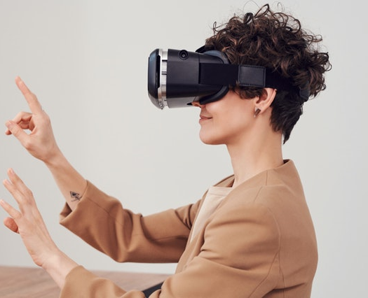
What is this Unit about?
Finish your own lesson plan
Discuss different plans
What is already good?
What could be improved?
Become a
Viral Skills Multiplier

Slide 3
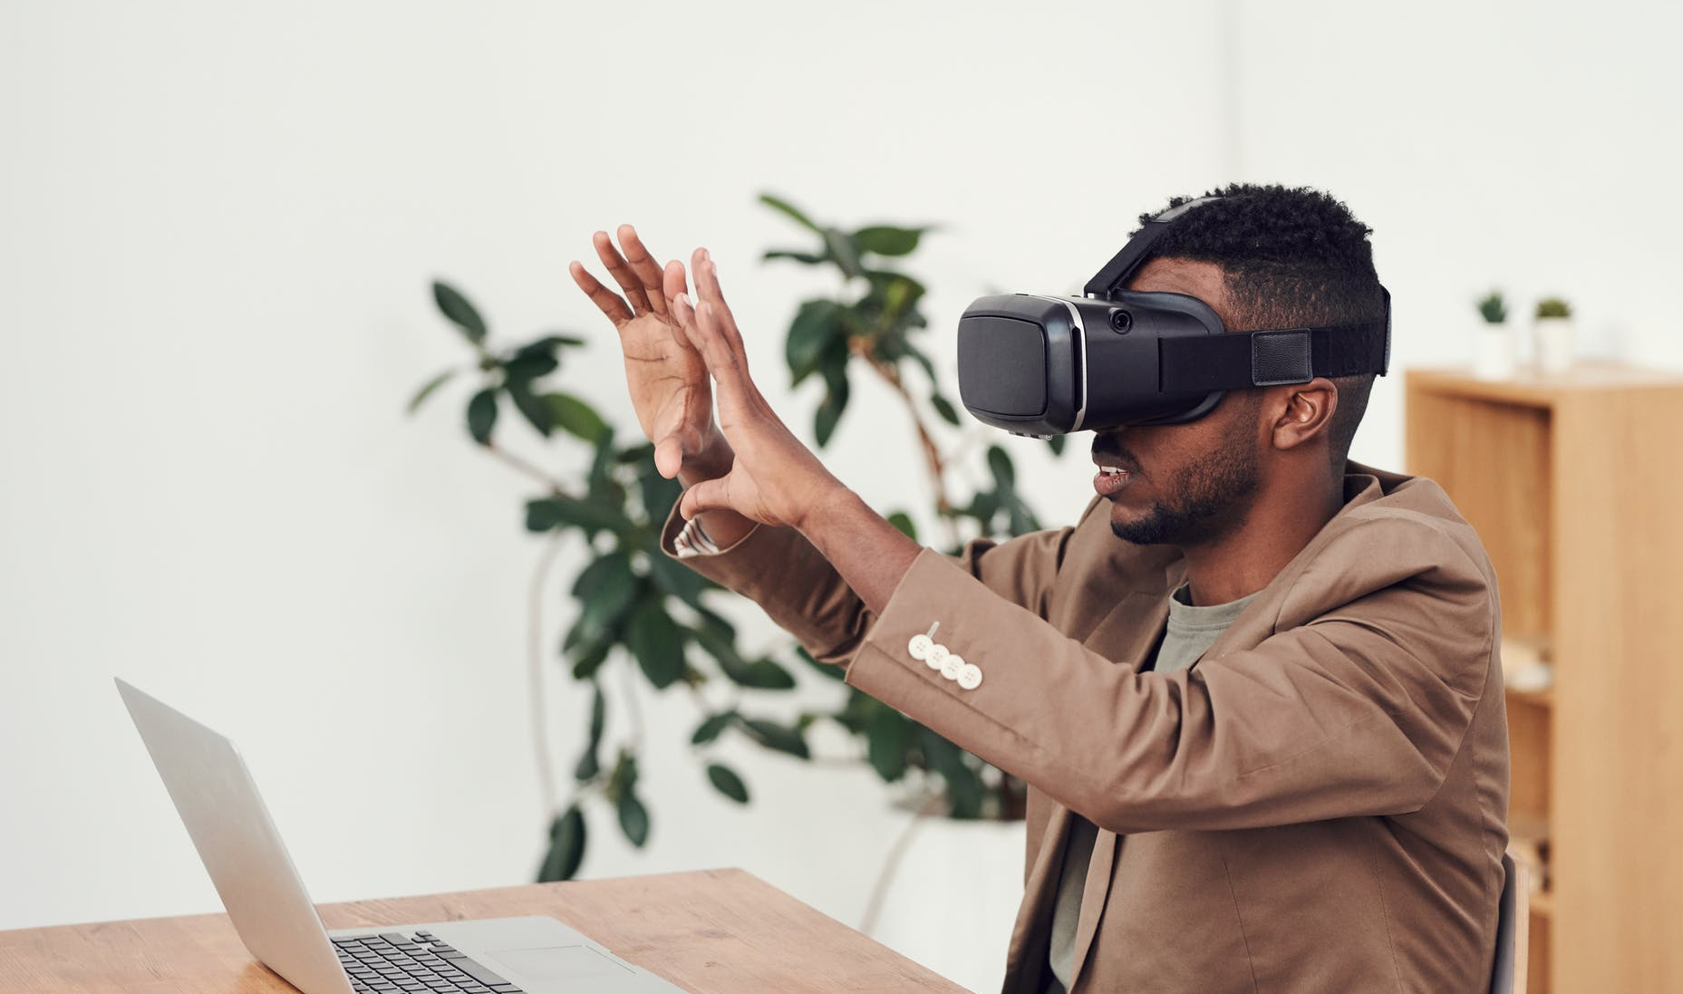
Time for the VR Lesson Plan
50 min.

Slide 4
Presentation
Please note your questions for the group discussion
Of individual lesson plans
Notes:
Please note your questions for the end of the presentations: Sprechblase

Slide 5
Group Discussion
Feedback to individual lesson plans
and open questions
Notes:
Stichwörter hinzufügen:

Slide 6
The Viral Skills Training Programme
Become an EU Viral Skills Educator Multiplier!

Slide 7
Overview
Notes:
Bild austauschen! Webinar

Slide 8
Objectives
After completing the ViRAL Skills Training Programme, the participants should be:
aware of and basically understand the world of VR and its temporary state of the art
familiar with the most common VR providers/systems and their basic pros and cons (e.g. prices, share of the market, quantity and quality of applications provided, specialisation on specific fields such as gaming, business/economy, medicine, education)
aware of the potential that VR technology has for the learning sector in general and in particular for adult learning
aware of the state of the art of the academic discussion concerning this field and what the general pros and cons are postulated by pedagogic science, but also by related fields such as social science or psychology
aware to what extent and under which frameworks VR learning can be applied successfully when working with low-skilled and low-qualified persons
aware what the 25 open source VR applications in the “ViRAL Skills E-Thek” are the most recommended ones by the partnership and how they can be utilised in adult training sessions, especially when working with low-skilled and low-qualified learners
familiar with at least 10 of the 25 recommended VR applications by having applied them actively in stand-alone learning by doing sessions
competent in applying VR sessions at own classes for adult (low-skilled and low-qualified) learners
competent in introducing the concept of VR learning and its advantages for adult education to others (such as managers and educators within their own or other organisations, learners, stakeholders and policy makers …)
competent to organise and implement the “ViRAL Skills Training Programme” for other educators or managers within adult education Directly from the proposal. May need proof reading.

Slide 9
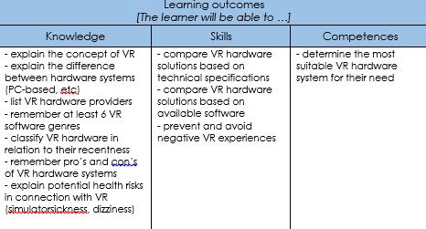
Unit 1
IntrodUction to VR (4h)
- introduction to the field of VR
- state of the art of hardware
and software developments
- pro’s and con’s of hardware
and software developments

Slide 10
Unit 2
- potential of VR in educational sector
- academic discussion
- state of the art of VR in education (EU and global

Slide 11
Unit 3
VR for low-skilled/qualified persons (4h)
- various groups of low-skilled or low-qualified persons (school drop outs, refugees, disabilities, …)
- how to reach these groups with VR
- how to work with these groups using VR

Slide 12
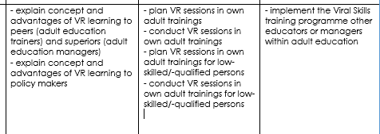
Unit 4
Mainstreaming Viral Skills (8h)
- How to improve VR learning at adult education level
- how to distribute and mainstream the project results
- mainstream usage of VR in adult education

Slide 13
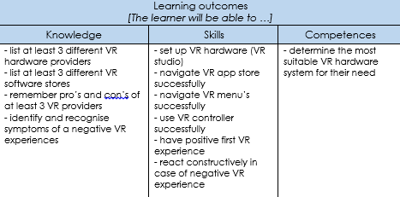
Unit 5
Introduction to VR hardware (4h)

Slide 14
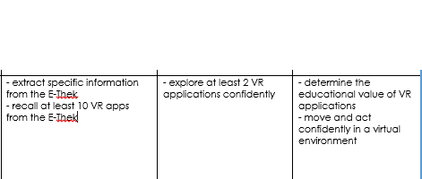
Unit 6
Introduction to the Viral Skills E-Thek (4h)
- introduction to the E-Thek
- exploration of best practice VR apps for adult education

Slide 15
Unit 7
Testing VR (12h)
- Testing Session 1 (4h)
- Testing Session 2 (4h)
- Testing Session 3 (4h)

Slide 16
Instructions for Self-directed Learning Phase

Slide 17
How to do a Webinar
Date | Webinar
Subscripe to Facebook and our YouTube Channel!
Notes:
How to do a webinar. 7 slots, webinar + datum hinzufügen

Slide 18
Feedback Assessment
Notes:
LINK AND QR-CODE!

Slide 19
Flashlight Method
Share one key word/phrase/sentence that summarises your experiences during this training!

