Slide 1
Unit 7: Testing Phase

Slide 2
Testing session 1

Slide 3
Recommended VR applications
As soon as the list is ready by consortium will be added here

Slide 4
VR learning applications
What do you consider as most important to be tested?

Slide 5
It’s your turn
In your team test 3 VR apps and complete the handout you have developed.
You have a total of 2 hours

Slide 6
Testing session 3
Subtitle

Slide 7
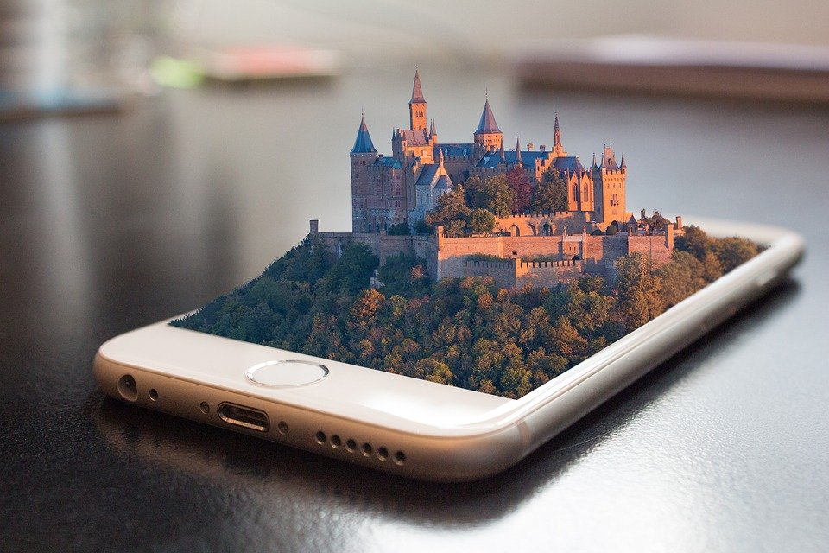
VR and low-skilled adults
How can a VR app supports low-skilled adults?
Notes:
Possible responses by participants:
facilitate their learning experiences.
increase their engagement
improve their overall performance
Also, hands-on learning techniques like VR education directly contribute to increased cognitive abilities such as memory, attention, and concentration
The more a learner is able to participate in life-like engagement, the easier it is to personally feel a connection to the subject material, making it easier for application and retention of the subject matter

Slide 8
VR applications used for low-skilled adults
List with applications (when the list is completed by consortium it will be added here)
Public Speaking VR
Nearpod
Alchemy VR

Slide 9
It’s your turn!
Test one application that is suitable for low-skilled adults
Note down the advantages/benefits an adult can have while using this app
Present the results

Slide 10
Thank you so much for your participation!

